Slide 1
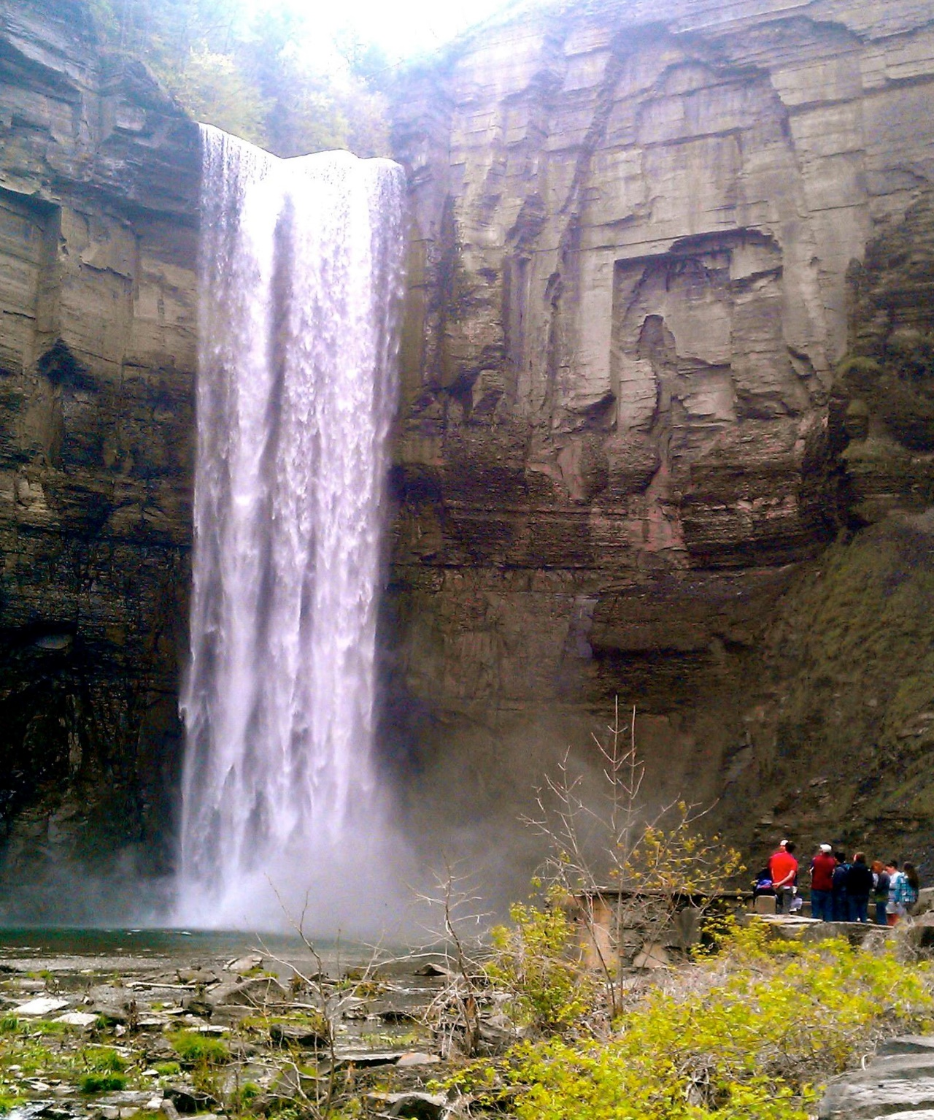
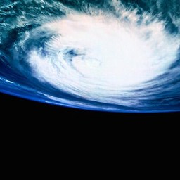
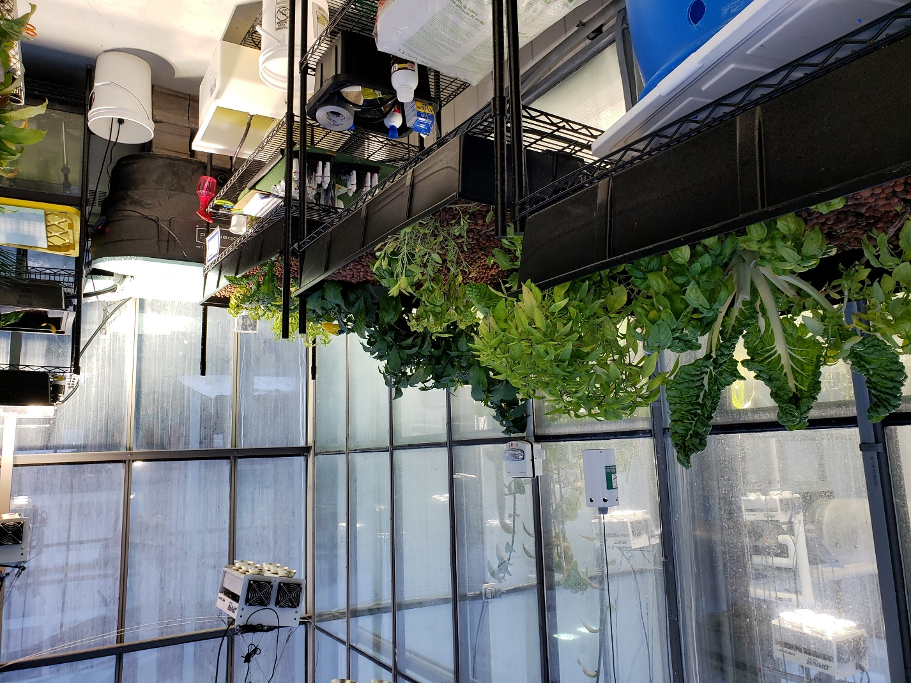
ENVS Courses
Spring 2022

Slide 2

Advising and Registration
ADVISING appointments
Oct 18 – Nov 1… please sign up EARLY!!
ON-LINE REGISTRATION begins Nov 2 Come prepared to advising appointments
Check out the “For Current Students” section of the ENVS website for FAQs

Slide 3
ENVS Career and Networking
Listen to, and network with, a panel of alumni discuss their post-Ithaca College experiences
How can you make the most of your IC education?
Get ideas for your own experiences/ internships/ jobs/ post-graduate education
Opportunity for students to ask questions in Breakout Rooms
Monday, November 15, 6-7:30 pm
https://ithaca.zoom.us/j/97719465843?pwd=RUh2c0hzUWlDandRelUwRHA4SFhsUT09
n

Slide 4
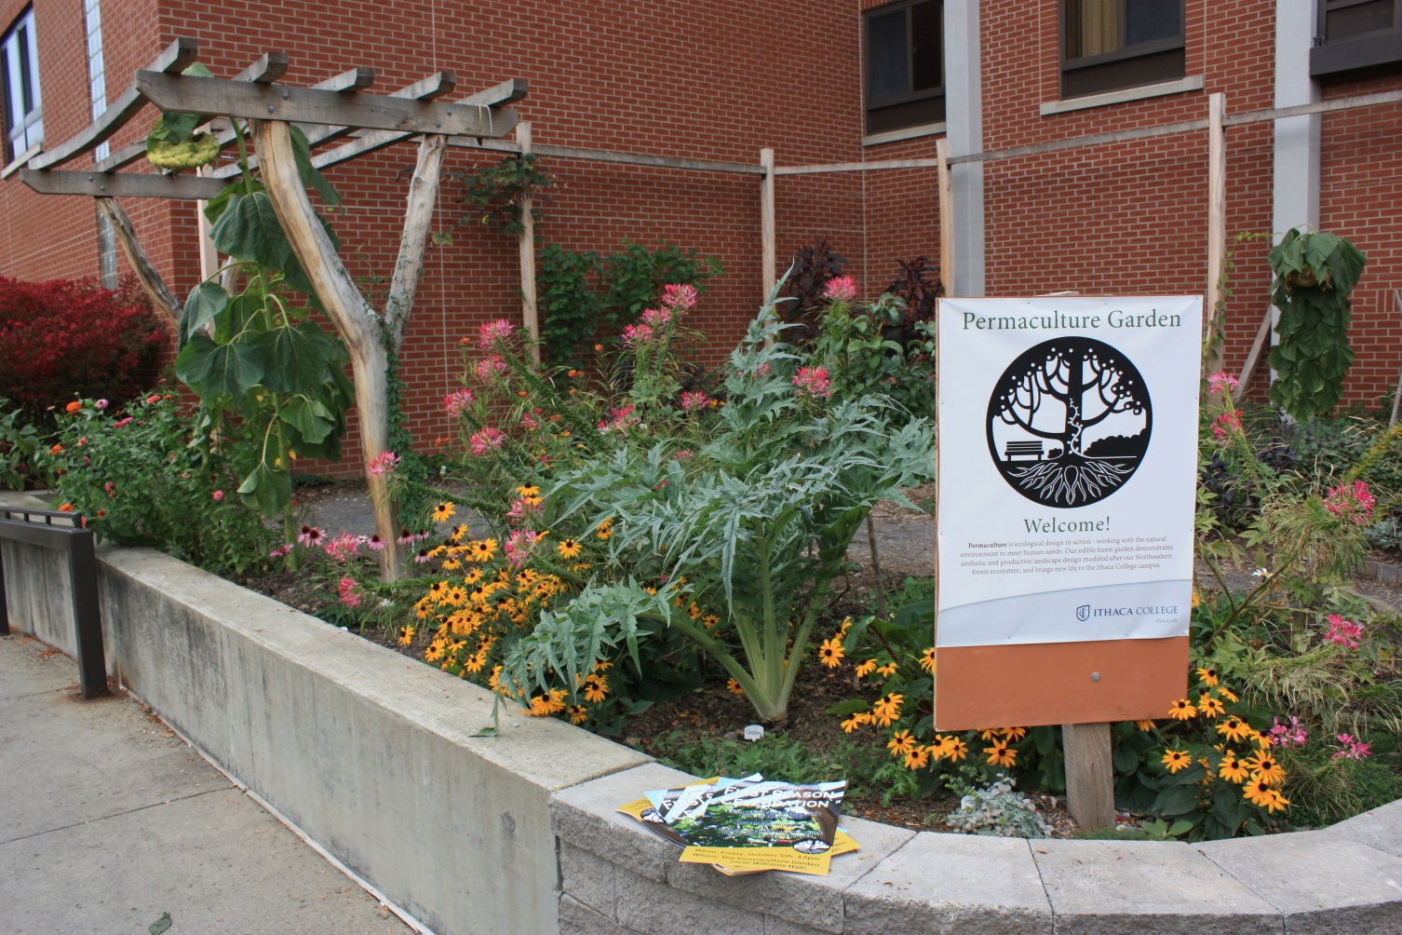
ENVS 104
Gardening Principles & Practices
Anne Stork
Spring Semester Block II
Fridays 10am-noon
1 credit, pass/fail
Learning outdoors in the organic
and permaculture gardens, this
hands-on course will introduce you to
working with soil and plants, and to learning how to grow your own food that is friendly to the earth.
If you are interested in being a course assistant for this class please contact Anne at astork@Ithaca.edu.

Slide 5
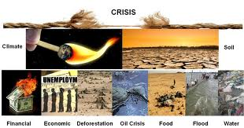
ENVS 110
The Environmental Crisis
Praneeta Mudaliar and Susan Allen
MWF 10-10:50 or MWF 1-1:50 pm
3 credits
This course will empower you to be an active participant in the global community
It will discuss current environmental issues, including global climate change, air and water pollution, deforestation, energy, waste, and more.

Slide 6
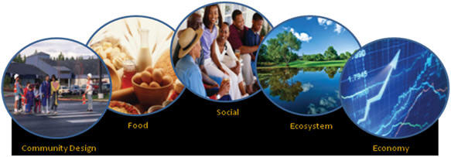
ENVS 112
Sustainability Principles & Practices
Paula Turkon
MWF 2-2:50 pm
or 3-3:50 pm
3 credits
Does not fulfill ENVS major requirements
Uses systems thinking approaches to examine the connection between four primary components of sustainability: economic, environmental, social equity, and health.
Students will learn about sustainability practices on campus and in the community and propose sustainable solutions for various scenarios.

Slide 7
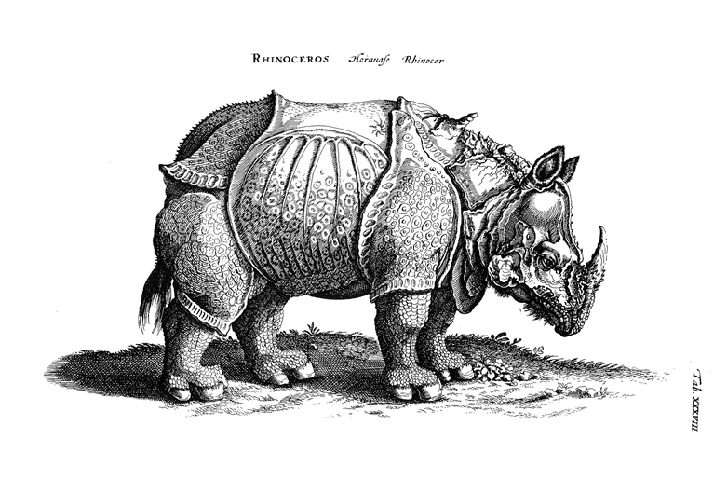
ENVS 119
Intro to Environmental Humanities
Michael Smith
MW 4 to 5:15 pm with Lab on F 11 to 11:50 am
4 credits
➲In this interdisciplinary course, we use the various humanities disciplines (literature, history, ethics, religion, art history) as lenses for examining human-environment interactions. How do human values shape our perceptions of and actions toward the world around us? How do we call upon these values and assumptions to tell stories about the world around us?

Slide 8
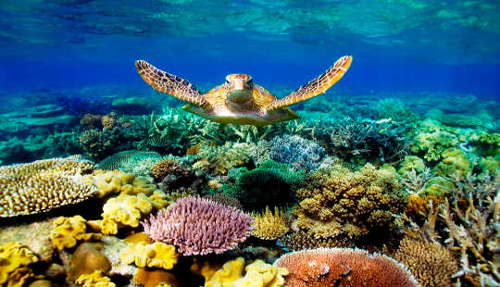
ENVS 121
Introduction to Environmental Science
Anne Stork
TR 9:25-10:40 + lab
4 credits
Required for all
ENVS majors!
We will use scientific principles to investigate the causes and solutions of a variety of environmental issues such as coral bleaching, ocean acidification, bioaccumulation of toxins, dead zones, impacts of invasive species on biodiversity and ozone effects on vegetation.

Slide 9
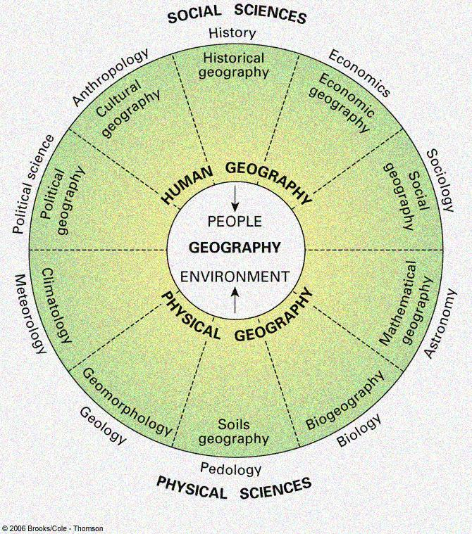
ENVS 220
Human-Environment Geography
Jake Brenner
MWF 11-11:50 am or 12-12:50 pm
3 credits
Prerequisite: Sophomore standing
Required for Environmental Studies majors
Learn about well-known environmental issues in terms of:
  Space
  Place
  Scale
  Globalization

Slide 10
History of American Environmental Thought (ENVS/HIST 270)
  Michael Smith
  TR 10:50-12:05 PM
  3 Credits
Environmental History—What Is It?: illuminate the interplay between human history and natural history, examining many of the permutations of “nature’s role in American history.”
Cultural Constructions of Nature: illuminate the ways in which Americans’ thinking about nature and the environment has changed during the past several centuries, exploring the ways Americans have projected human values onto nature; e.g., why some people have described the forests as sanctu-aries and others have described them as “board feet.”
Doing History: how do historians look at sources from the past (including the landscape) and use them to tell a story that both makes sense and is well-supported by the sources.
Course Format: Reading, discussion, some lecture, several papers, local environmental history rsch. project.

Slide 11
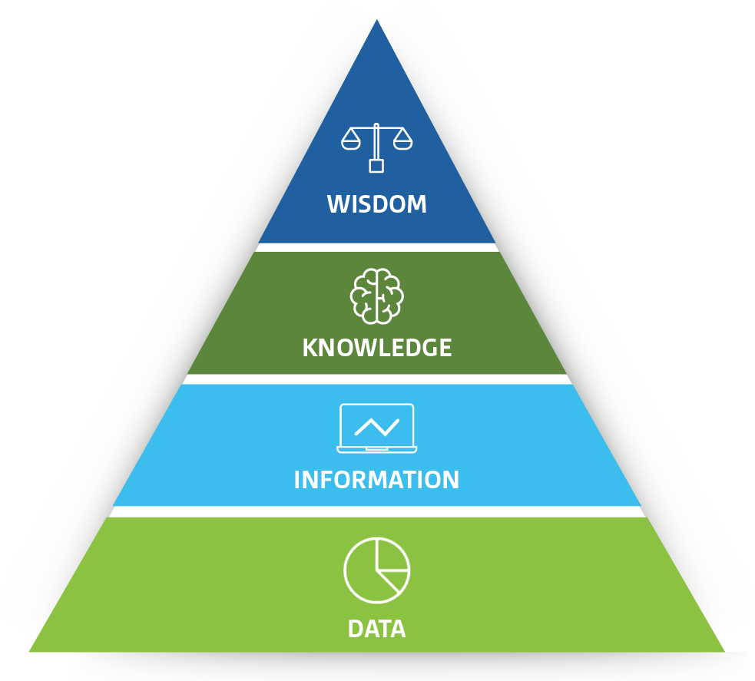
ENVS 292:
Quantitative Approaches to Environmental Issues
New Course!
Susan Allen
MWF 9-9:50 AM
3 credits
Prereq: ENVS 121 (ES&T)
QL designation
Subs for EITHER Calc or Stats
Data analysis for objective decision making and policy formulation
Research design, big data, graphs, stats, communication of results
YOU NEED THIS! Whether you know it or not ☺

Slide 12
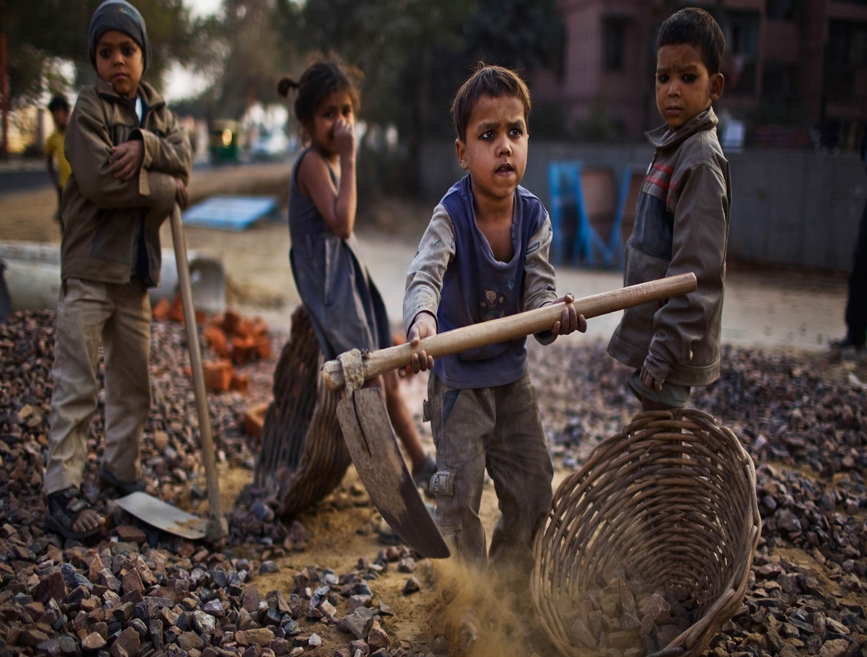
ENVS 31200 Topics in Environmental Communication: ROOTS
Fae Dremock
TR 4-5:15 pm
3 credits
ENVS 300 level/tools elective
Tired of plowing through books? Dig up the dirt instead! Work as a team in hands-on science writing -- interviews, podcasts, features, and web page design for Roots, our online science outreach journal!

Slide 13

ENVS 321:
Governing Socio-Ecological Systems
New Course!
Praneeta Mudaliar
TR 9:25-10:40 AM
3 credits
Prerequisites: ENVS 220 or ENVS 213 or ENVS 337
Polycentric governance
Human rights
Integrated Water Resource Management
Multi-level governance
Adaptive Governance
Hydro-politics
Governance of socio-ecological systems
Environmentalism: diversity, justice, and sustainability
Artwork by Alexandra Boawman @scripta_bene / NY Times)

Slide 14
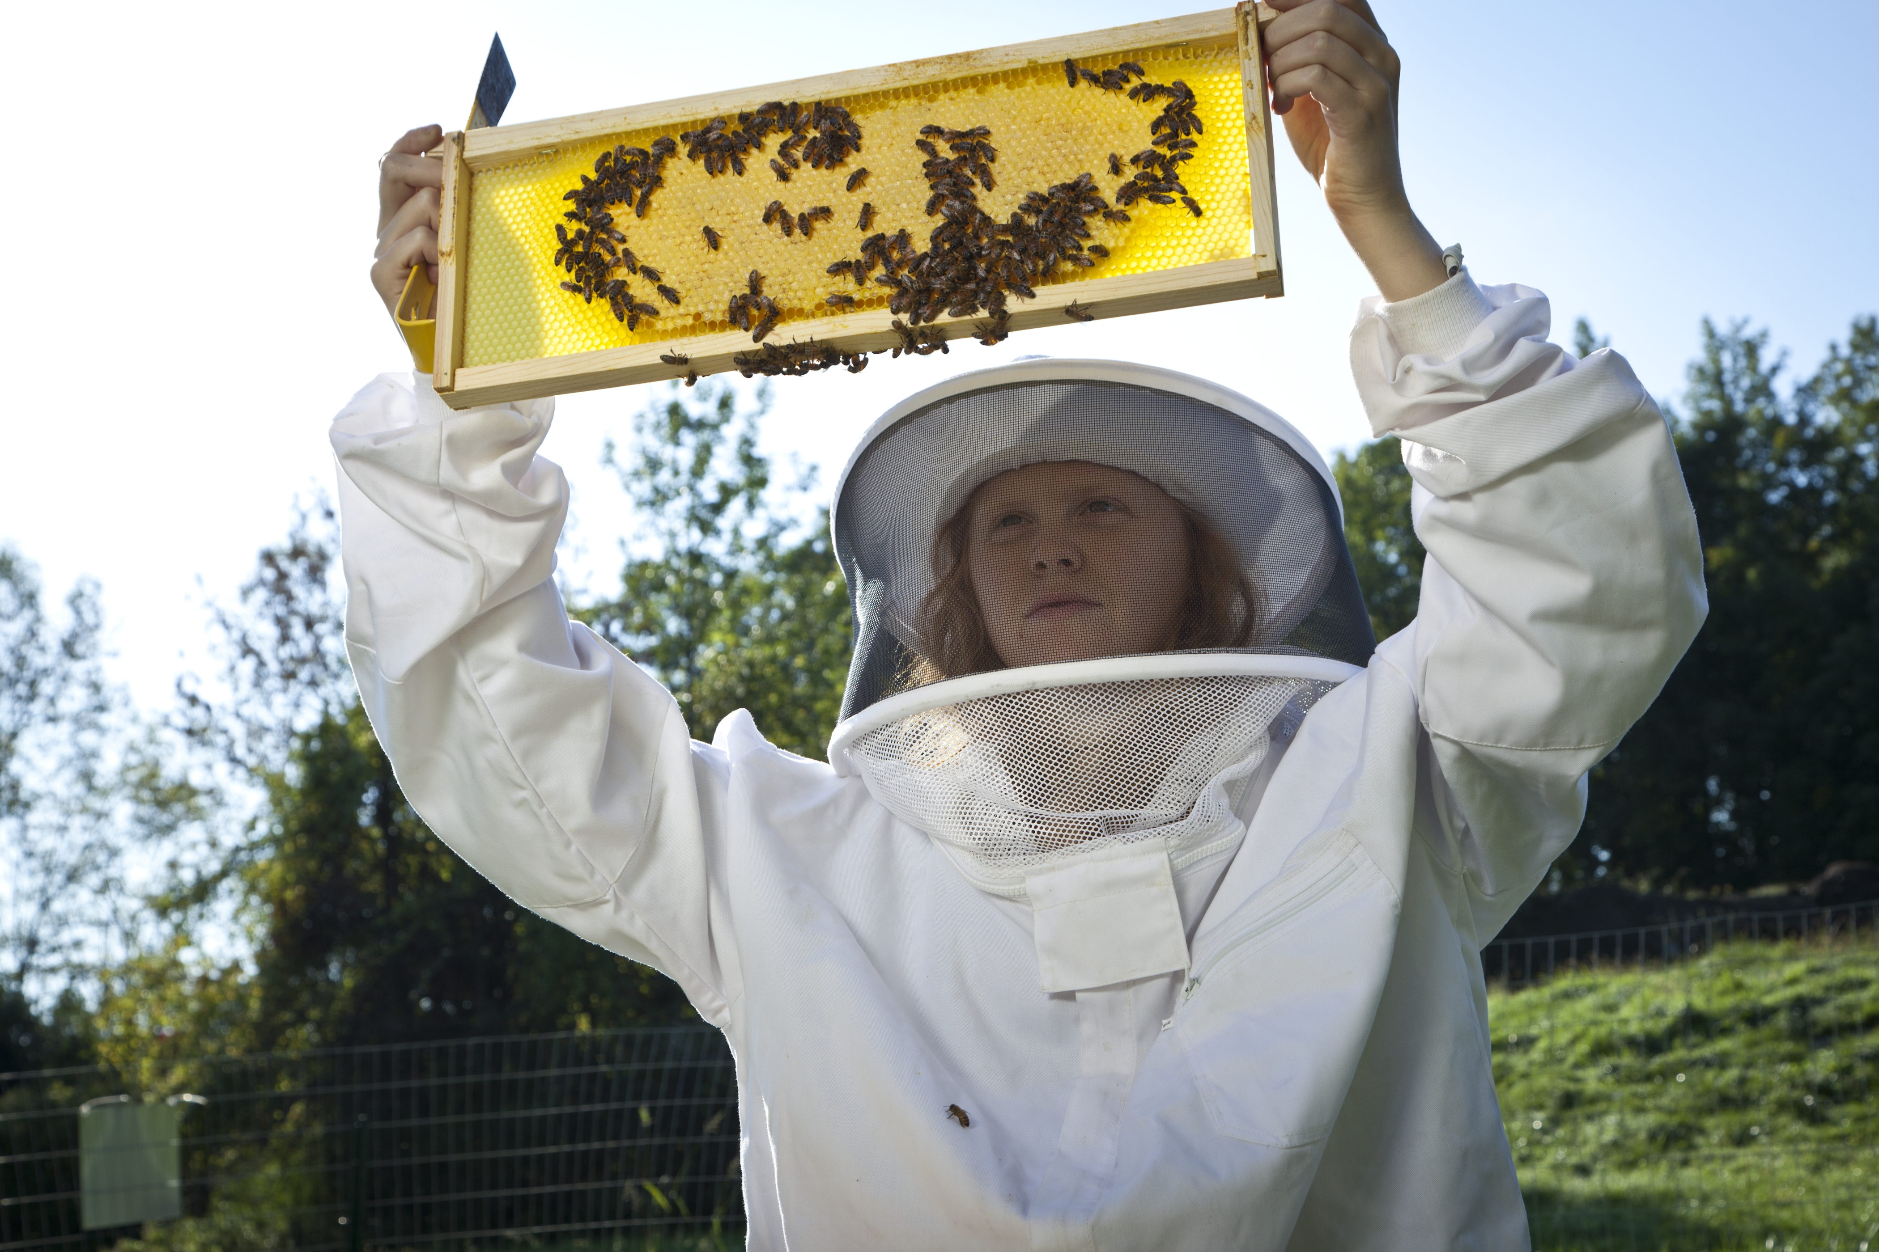
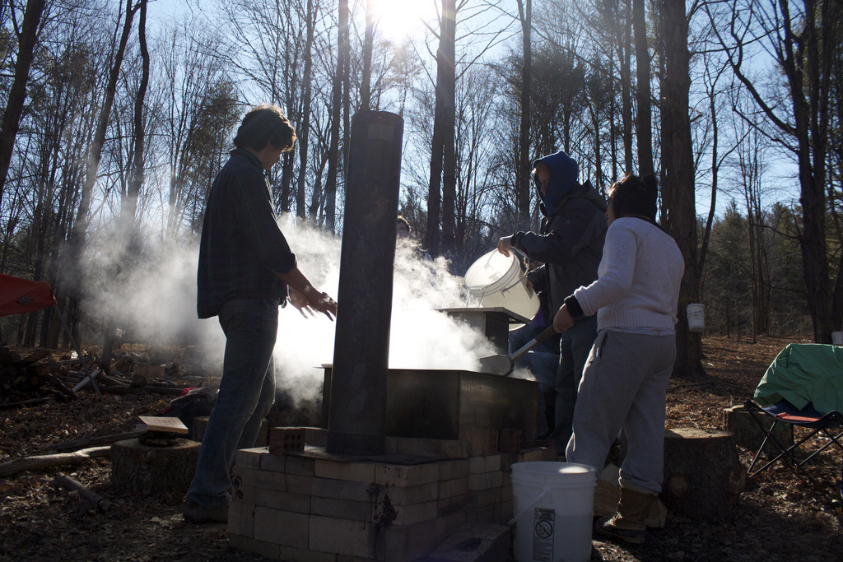
ENVS 351
Farming the Forest: Non-Timber Forest Products
Jason Hamilton
4 credits
W 1:10 to 3:50 pm
Prereqs: two ENVS courses; or permission of instructor
Hands-on, learning-by-doing course where students will explore forest management and work w/student-run non-timber products micro-enterprises.

Slide 15
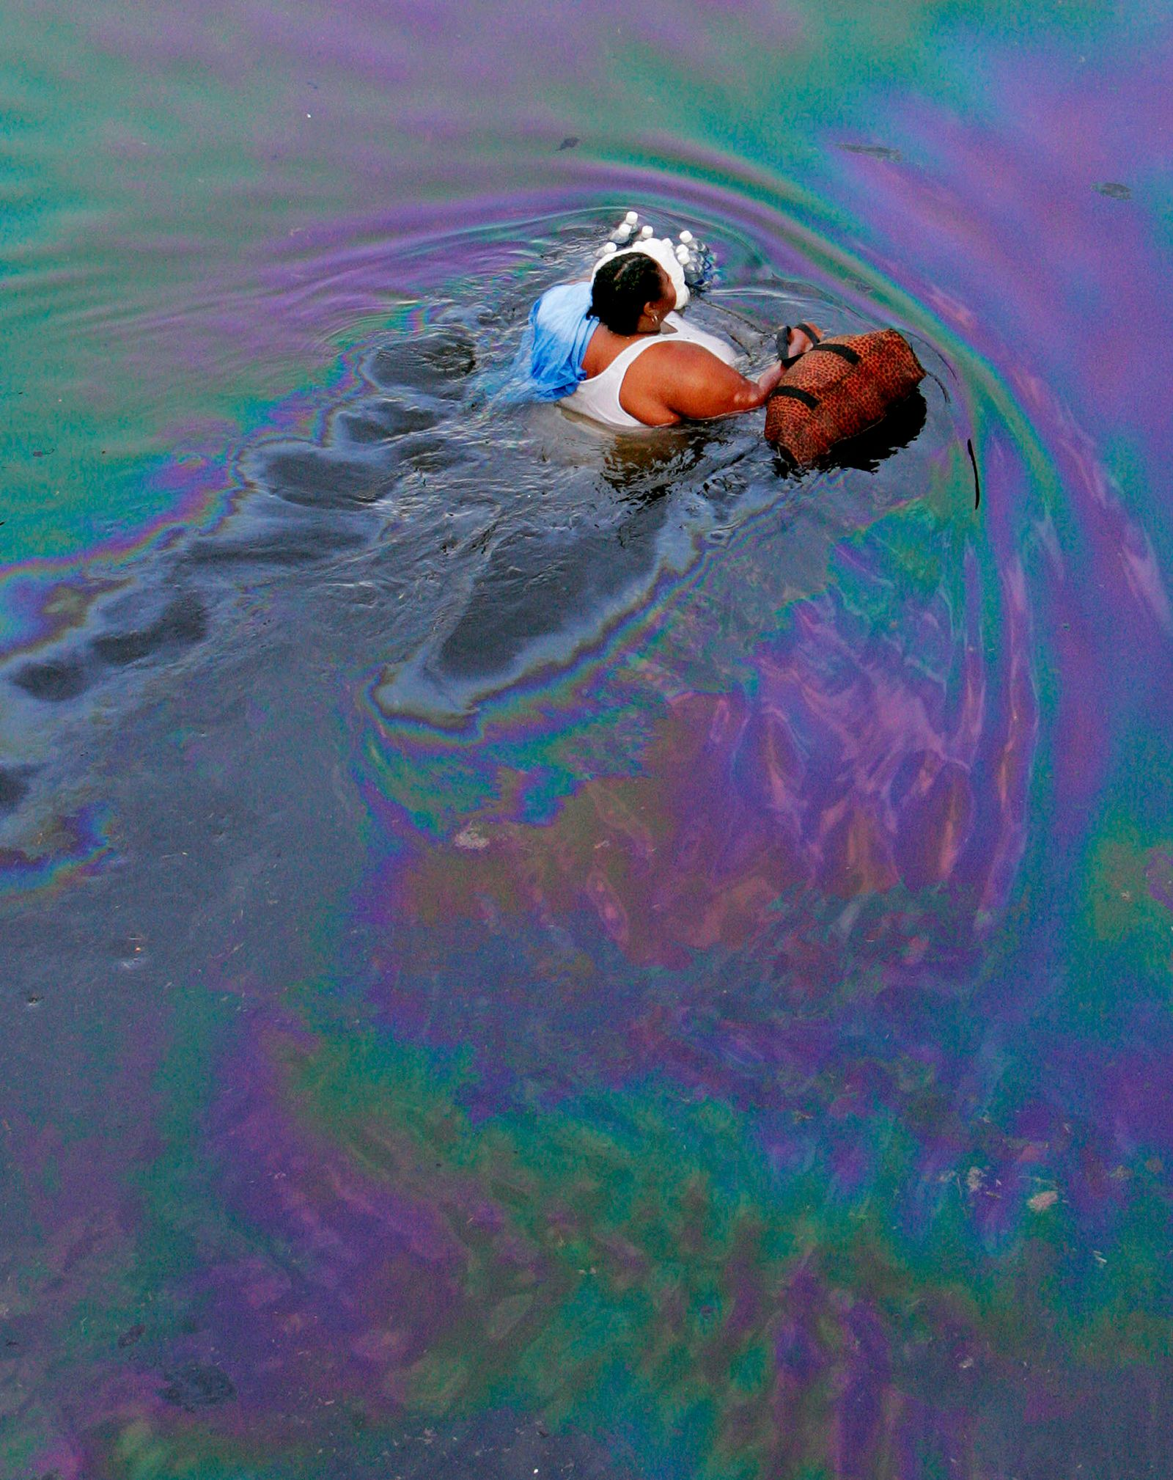
ENVS 36000
Topics in Environmental Humanities--
The Unnatural Disaster: Katrina
Fae Dremock
MW 4:00-5:15
3 credits
ICC Writing Intensive
Junior standing
or consent of instructor
In this course, we explore the human stories in Katrina, talk about disaster management from an ethical perspective, and narrate the unnatural disasters we face.

Slide 16
ENVS 41000
Mammals of the Northeast:
Track, Sign, Habitat, and Behavior
Jason Hamilton
TR 10:50 – 12:05 pm
Lab: T 1:10 to 3:50 pm
4 credits
Advanced ENVS elective, Tools, Restricted Science Elective

Slide 17
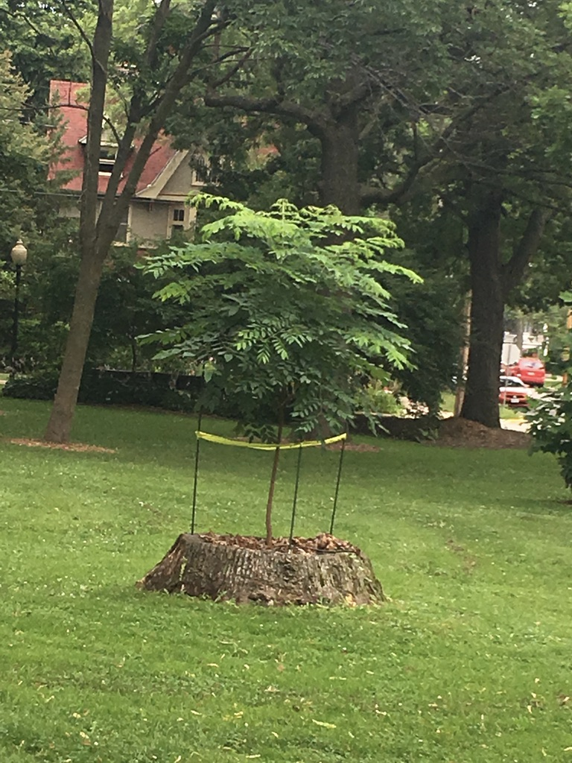
ENVS 475 –
Advanced Environmental Seminar
Susan Allen
M 12 to 12:50 pm
Full Semester
1 credit
Required of all seniors!
Finish the ICC!!!
Prepare for the future. . .

Slide 18
ENVS Honors
Requirements: Students with a minimum GPA in Environmental Studies and Sciences courses of 3.50 and an overall GPA of 3.30 may apply for the honors program
How to apply: Application made to the ENVS curriculum committee via ENVS website
Deadline to apply: End of first semester of junior year
Visit the ENVS website for more information and to fill out the online application

Slide 19
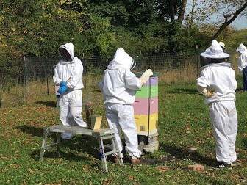

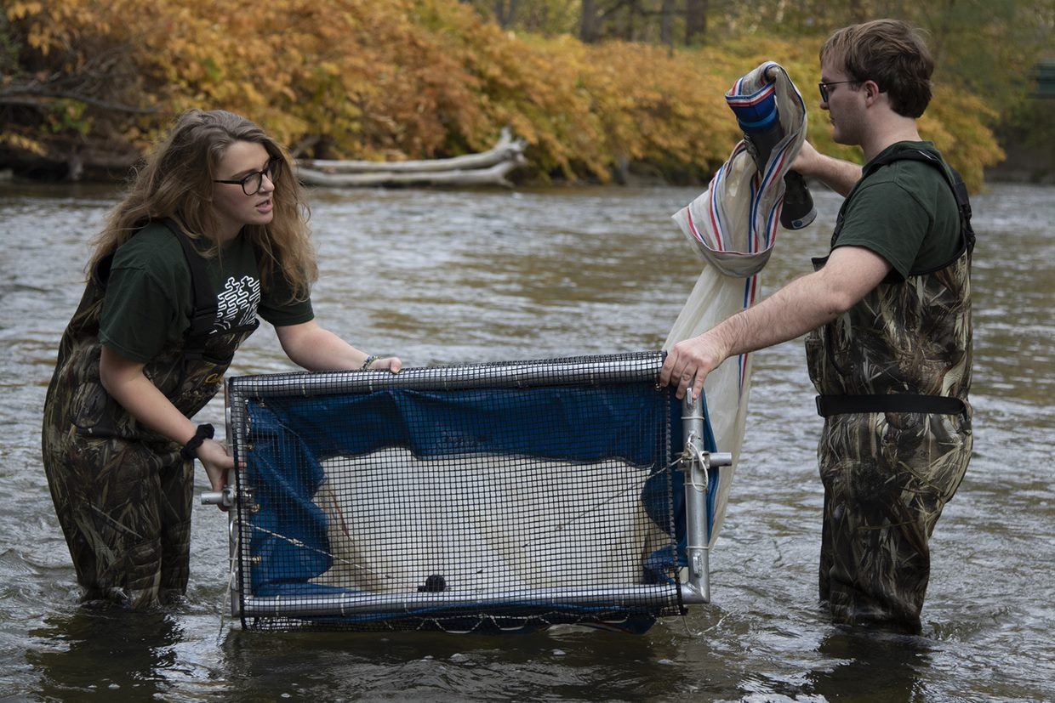
Research, Independent Study
& Internships
ENVS 201, 301, 402, 490 and 495
Many opportunities available …..
Contact faculty member directly
if you’re interested.

Slide 20

Honors 23007 Winter Wonderland: Tracking & the Art of Seeing in Winter
Jason Hamilton
Thursday 2:35-3:50 pm
1 credit Honors seminar
Nature doesn’t go to sleep in the winter… come outside and let's see what's going on!
This seminar will be a face-to-face encounter with the IC Natural Lands. Students will learn how to read a forest, examining it for signs of life and health, through tracking.
You’ll never see the woods in the same way after taking this seminar!

Slide 21
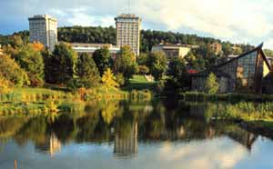
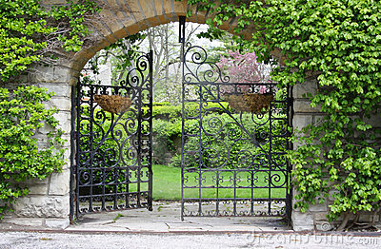
Courses from Other Departments

Slide 22
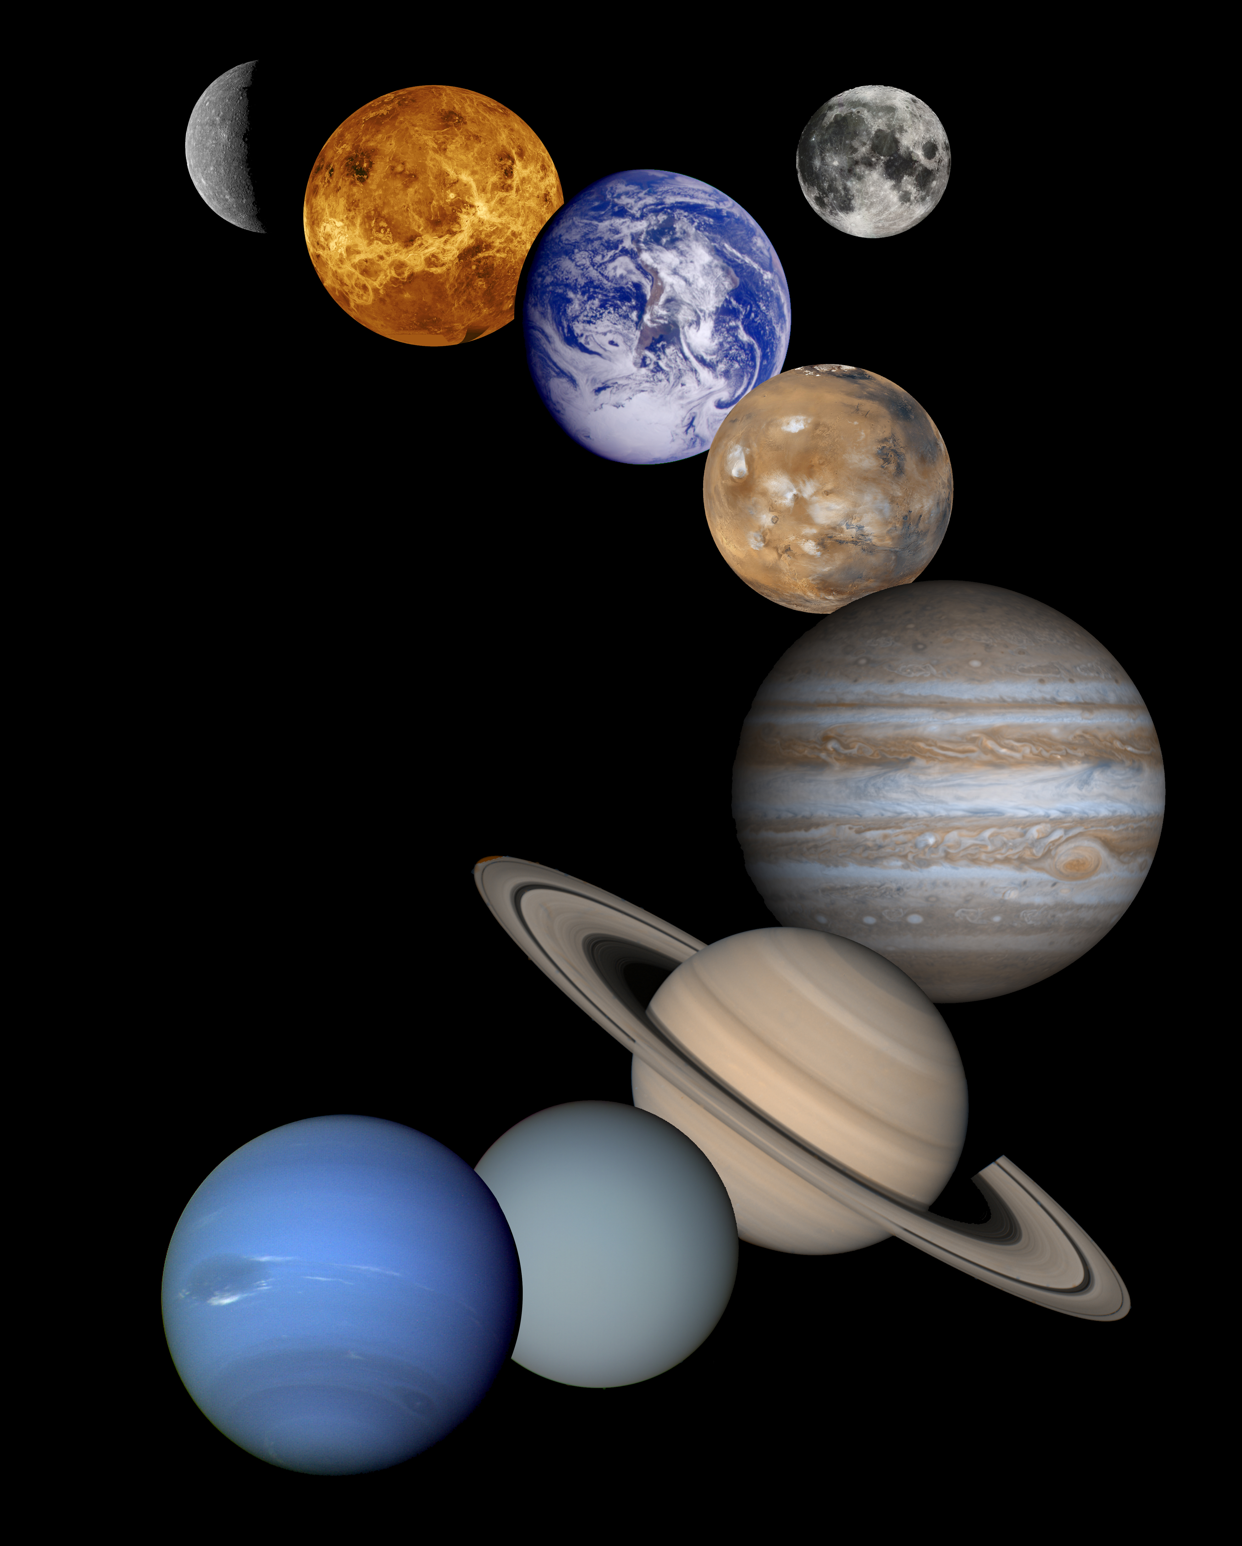
ASTR 17400
Solar System Astonomy
Matt Price – mprice@ithaca.edu
TR 10:50 – 12:05 pm
Fulfills WOS theme, lll theme and
NS perspective
Geological Systems among planetary bodies
Hydrological Systems: Where is water?
Atmospheric Systems: runaway greenhouse and no greenhouse
Biological Systems: What is life? Where is life?
Seasons on earth and other planets
Moons and their importance

Slide 23

MATH 159
Introduction to R
Thomas Pfaff
W 3 to 3:50 pm
Contact Dr. Pfaff with any questions
at tpfaff@Ithaca.edu
1 credit
This is a 1-credit introduction to R. The course focuses on problem solving through simulations in R. Students will learn some basics of simulations, graphing, and managing data in R.

Slide 24

MATH 221
Data Analysis w/ArcGIS
Thomas Pfaff
TR 2:35 – 3:50 pm
Contact Dr. Pfaff with any questions
at tpfaff@Ithaca.edu
Fulfills Tools or ENVS elective
Provides an introduction to spatial data management, analysis, modelling and visualization, and their applications, with a focus on problem solving with GIS. The context for applications in this course will mainly be environmental. The popular ArcGIS software will be used. Prerequisites: MATH 11100, MATH 14400, MATH 14500, or COMP 12400. (S,Y)

Slide 25

MATH 16500
Quantifying Sustainability
Emilie Wiesner: ewiesner@ithaca.edu
MWF 9 to 9:50 AM
How do we meet the needs of the present without compromising the ability of future generations to meet their own needs? This is the fundamental question of sustainability. Quantitative information is a key component to understanding the problems and solutions available. In this class, we'll use simple mathematical tools to help understand the issues, make more informed personal choices and weigh in on society wide policy.

Slide 26
CHEM 121
Principles of Chemistry
Meets MWF 9-9:50 AM plus co-requisite lab CHEM 12200 on R 1:10-3:40pm
4 cred
Required for Env Science majors
.

Slide 27

HISTORY OF THE FUTURE
HIST 272—T/H, 10:50 PM
Premise: How past societies imagined their future can reveal a great deal about who they were.
Major Course Topics:
The Climate Crisis &Environmental Futures
Apocalyptic Visions of the Future
Utopian Visions of the Future
History of the Idea of Progress
Technology and the Future
Media Depictions of the Future
The Future Human
Counts as humanities perspective course.

Slide 28


