Slide 1
HIST 270—History of American Environmental Thought Michael Smith T/H 10:50-12:05
Environmental History—What Is It?: We explore the interplay between human history and natural history, examining many of the permutations of “nature’s role in American history.”
Cultural Constructions of Nature: We examine the ways in which Americans’ thinking about nature and the environment has changed during the past several centuries, exploring the ways Americans have projected human values onto nature; e.g., why some people have described the forests as sanctuaries and others have described them as “board feet.”
Doing History: We practice using evidence from the past (including the landscape) to tell a story that both makes sense and is well-supported by the sources. The course includes an extended archival research project at the History Center in Tompkins County.

Slide 2
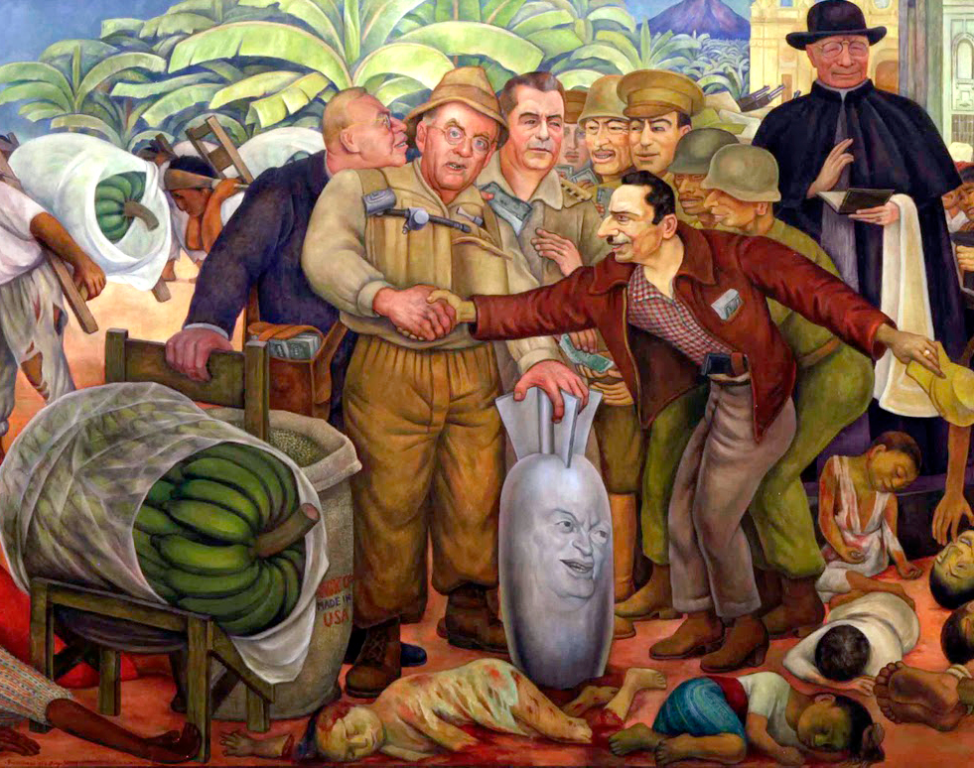
Revolution and Counterrevolution in the Americas
HIST 38800-01
MWF 4:00 – 5:15

Slide 3
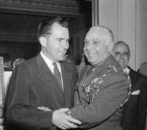
Americans in Latin America during the Cold War
HIST 48200
TR 1:10pm-2:25pm

Slide 4
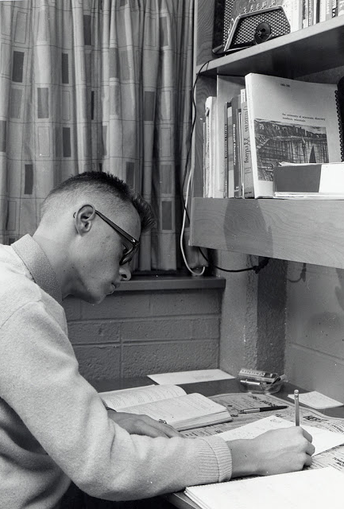
History Capstone
HIST 494
Thursday 235pm

Slide 5
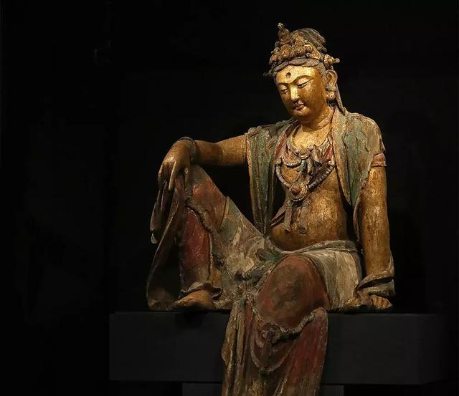
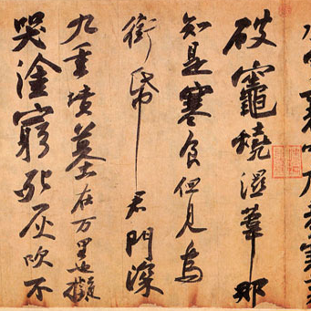
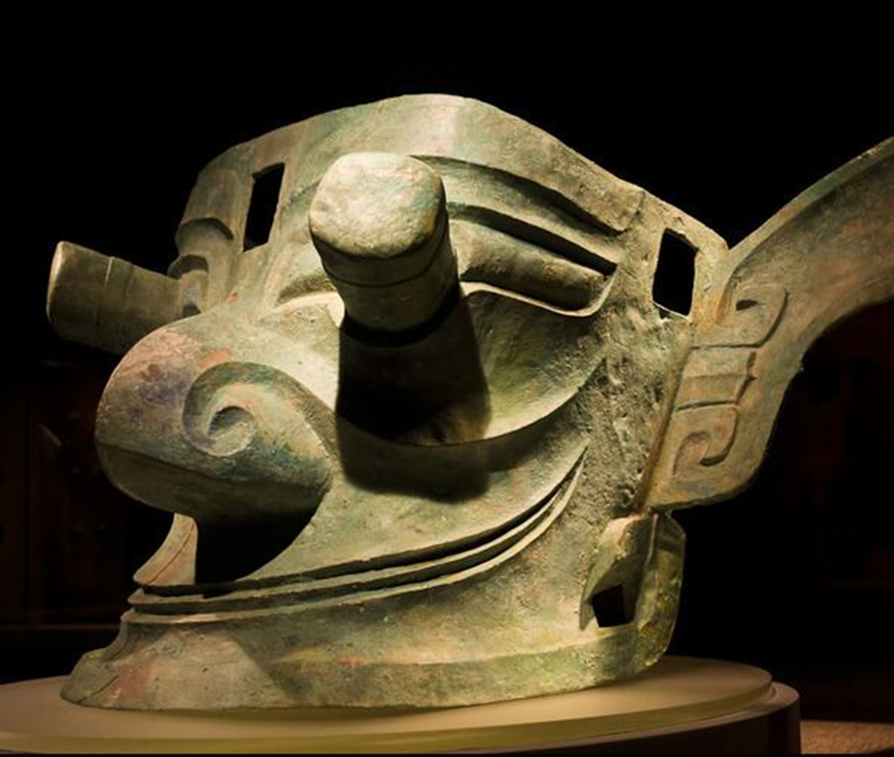
HIST 195 Made In China: A History of Chinese Artifacts before 1800 Professor Zoe Shan LIN TR 2:35pm
This course introduces students to the cultural history behind Chinese artifacts, especially those found in major museums, including bronze vessels, mortuary objects, Buddhist statues, ceramics, scroll paintings, etc. Through the examination of these objects and documents related to them, students explore critical themes in the formation of the "Chinese culture": the diverse origins of the civilization, indigenous beliefs and religious practices in ancient China, the incorporation of Buddhism into Chinese culture, interactions between elite and popular cultures, and China's participation in global exchanges in the premodern period
Designation: Diversity; Global History; Anthropology – Cultural; Anthro-Arch & Past Cultures

Slide 6
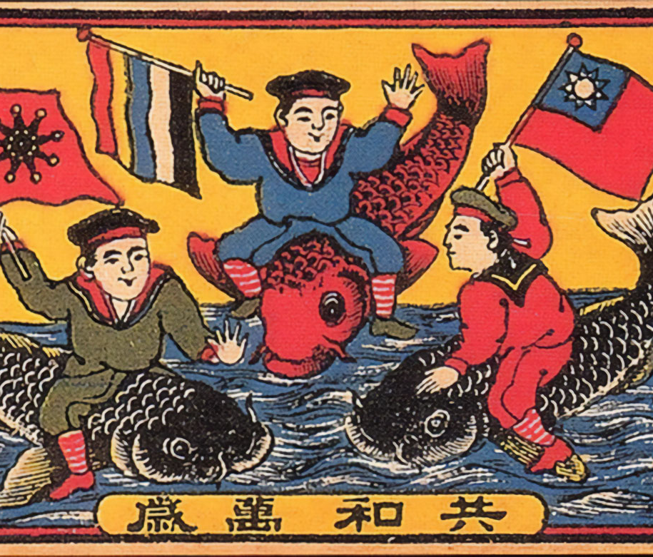
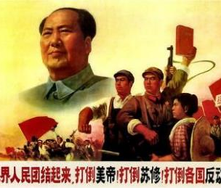
History 216: Revolutions in 20th-Century China MWF 11-11:50 Prof. Zoe Shan Lin
This course examines the historical path of China from an empire to a republic and a communist regime through three revolutions: the 1911 revolution, the communist revolution, and the cultural revolution. While exploring the backgrounds, processes, and dynamics of these revolutions, the course focuses on themes including modernization, nationalism, gender, and the meanings of revolutions to people of various classes and interests.
Attributes: Global History; Comparative & Int'l - AA Min; Asian American Studies Elect

Slide 7
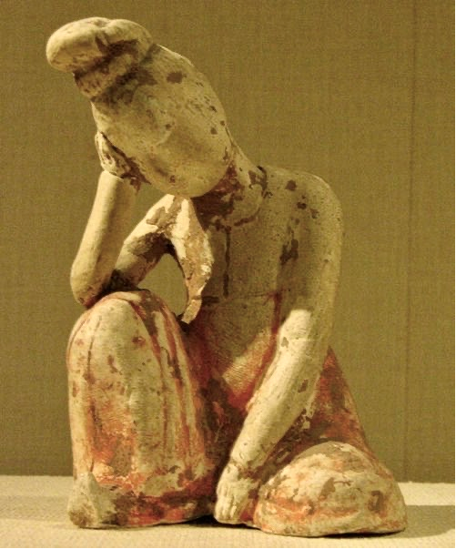
HIST 345: Gender and Family in Imperial China, 221 BCE to 1911
Professor Zoe Shan LIN: MWF 3-3:50 PM
Were women always and universally devalued and miserable throughout pre-modern China? How were gender relations and family dynamics intersected with philosophical ideals, religious values, political agendas, and economic developments? How did individuals, both male and female, navigate available choices to construct meaningful lives? This course explores these questions by investigating the changing nature of gender relations and family dynamics across China’s imperial period, from roughly 200 BCE to the early twentieth century.
Course Attributes: Global History; Comparative & Int'l - AA Min; meets WGST elective and 300-level elective requirements
Prerequisites: One 200-level history course.
If you have questions or would like an override, please email me: zslin@ithaca.edu.

Slide 8
History 168: 1968, a U.S. Revolution
Prof. Michael Trotti
A tour of the most tumultuous year of a transformative era:
turning points in Vietnam and in Civil Rights,
the heyday of the counterculture,
plus a race to the moon!
Explore the year when “Law and Order” shared the stage with “Yippies” putting a pig forward for the Presidency.

Slide 9
HIST 275 History of U.S. Popular Culture
From the early novel to the penny press to minstrelsy to P.T. Barnum to Burlesque to photography to baseball to the Columbian Exposition to Coney Island to Nickelodeons to Tarzan to radio to Charlie Chaplin to propaganda to the Motion Picture Production Code to integration of sports to TV’s sexism to ‘60s counterculture to contemporary culture’s obsession with technology…
… this course covers the impact of two centuries of American pop culture.
Prof: Michael Trotti

Slide 10
HIST 483: U.S. Seminar – The Greatest and Gravest Generation, 1939-55
From Depression to World War to Cold War, this generation has been called the greatest for the amount of turmoil they lived through and the foundations of prosperity they built.
But from red scare to civil rights to the environment and more, this generation also built a host of grave challenges we now face.

Slide 11
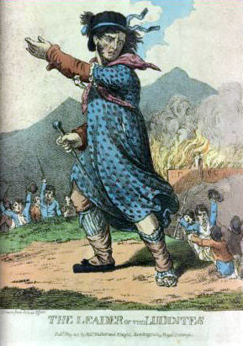
History 141: From the Margins: European Social History, 1400-1945 MWF 2-2:50 Prof. Breuer
This course traces the history of minority and marginal groups in Europe from the Renaissance to the end of the Second World War. It carries diversity designation for the ICC.

Slide 12
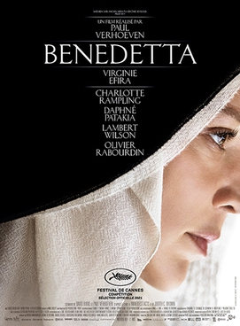
Microhistories: Gender, Religion, and Agency in Europe, 1350-1650
HIST 2XXXX (TBD)
MWF 1:00-1:50 p.m.
Writing Intensive

Slide 13
History 106: History in the News: Global Identities & the Search for Justice
Introduces the field of contemporary history through an examination of current events and issues. Students follow international developments and offer historical contexts and evaluations within themes of global identities and the search for justice through the paradigm of globalization and human rights.
Prof. Wasyliw
MWF 10 am and Noon

Slide 15
HIST 352: Monks, Heretics, and Scholars Prof. Klemm. TR 9:25
This course examines cultural changes in Europe from the 12th to early 14th centuries. This was a period of great change and growth (until the Black Death), witnessing the creation of universities, nascent states, gothic art and architecture, and new habits of thinking about the natural and supernatural worlds.

Slide 16
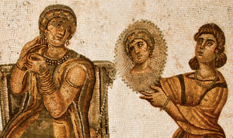
Body and Society in the Ancient World Prof. Klemm TR 2:35 Prof. Klemm TR 2:35
This class examines ancient Greek and Roman social history through the lens of bodies and their constraints. Topics include mythical paradigms of gendered behavior, sexuality and marriage, legal rights and restrictions for different classes, fertility cults, practices of enslavement, gladiators and other blood sport, treatment of the dead, ancient medical theory and practice, and ideas about the body and soul.

