Slide 1
Caring for others without losing ourselves
Self-compassion practice and discussion group
Fall 2022

Slide 2
Reminders
The goal of self-compassion practice is to treat ourselves like we would treat a good friend.
The components of self-compassion are mindfulness, common humanity, and mindfulness.
Self-compassion invites us to use encouragement rather than judgment as motivation.

Slide 3
How can we Cultivate care for ourselves and others?

Slide 4
Care for others
Concern for the well-being of others is instilled in us from a young age
And is valued in religious traditions
Care for others is an important part of our human programming
Working for the good of the community is important for survival
Our brains may be wired to help us understand and respond to others
But the hype about “mirror neurons” is outpacing the science…
https://www.ncbi.nlm.nih.gov/pmc/articles/PMC3898692/

Slide 5
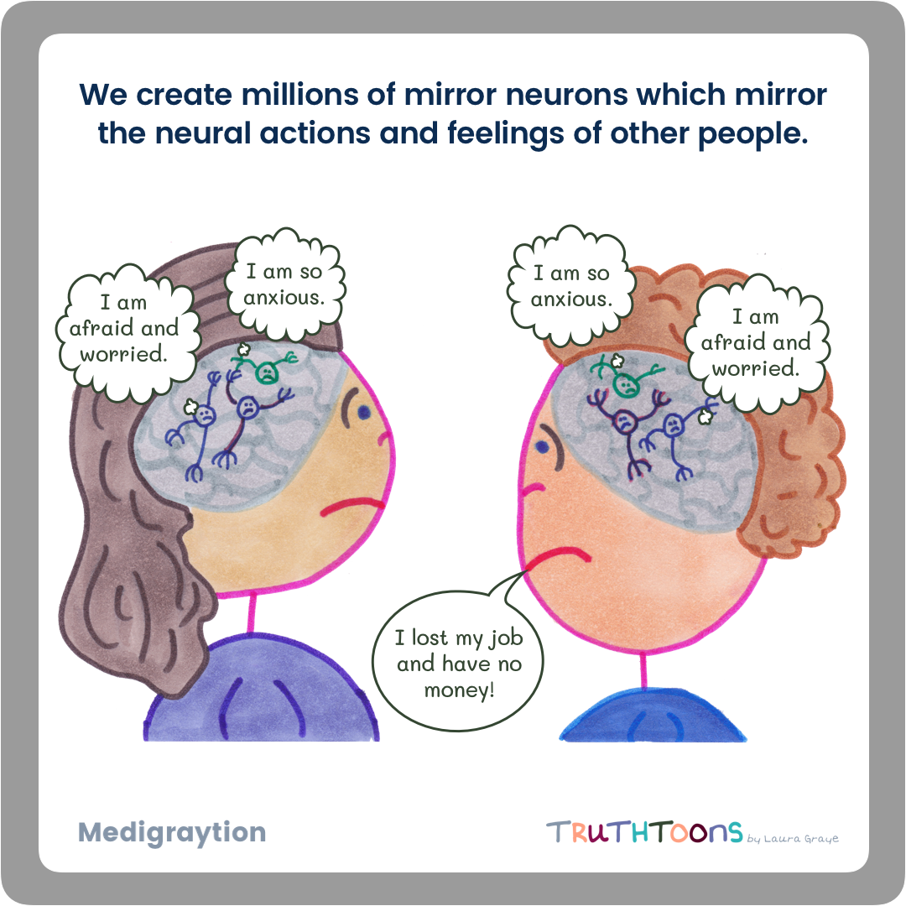
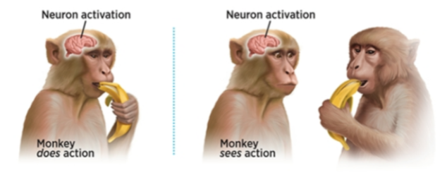

Slide 6
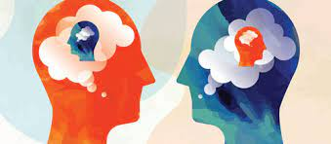
empathy
Empathy “is an emotional skill set that allows us to understand what someone is experiencing and to reflect back that understanding.”
Cognitive empathy
Perspective-taking
Affective empathy
Emotional attunement with another person’s experience
Brené Brown “Atlas of the Heart”

Slide 7
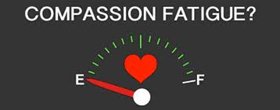
Empathy → compassion
Recognizing the suffering of another = empathy
Being able to hold the suffering of another with a desire to alleviate it = compassion
“Compassion fatigue” is typically “empathy fatigue”

Slide 8
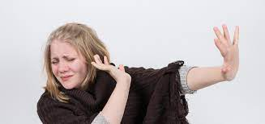
Common reactions to others’ suffering
pity
Avoidance
redirecting
“Gee, that’s too bad.”
“Poor you.”
“It’s not so bad.”
“We all love you.”
“It’s ______ fault.”
“Let’s fix this.”

Slide 9
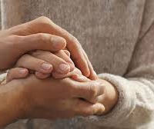
Holding suffering
Many of these less-helpful reactions arise because we want to avoid feeling the distress of the other person
Practicing so that we recognize our own suffering and offer ourselves kindness…
Helps us offer that to others

Slide 10
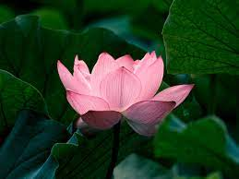
A word about buddhist practice
Buddhism teaches practitioners to cultivate the four brahmaviharas
Metta = lovingkindness
Karuna = compassion
Mudita = sympathetic joy
Upekkha = equanimity
In these practices one typically chooses phrases to focus on
Neff and Germer’s lovingkindness practices are rooted in this tradition
The phrases are not affirmations but are a way of cultivating beneficial mental habits

Slide 11
Practice
Loving-kindness (p. 65) and giving and receiving compassion (p. 112)
May I/You/We Be Happy
May I/You/We Be Healthy
May I/You/We Be Peaceful
May I/You/We Live With Ease
(Finding your own phrases – see page 71)

Slide 12
Discussion
Facilitator = student whose last name is closest to “a”
Discussion questions:
Have others ever reacted to your suffering with pity, avoidance, or redirecting? What impact did that have on you?
Have you ever reacted to others with pity, avoidance, or redirecting? How did they react?
If there is someone compassionate in your life, how do they show this in their interactions with you?
If you’ve ever experienced compassion fatigue or burnout, what have you tried that helps you?

