Slide 1

History Courses
Fall 2025

Slide 2
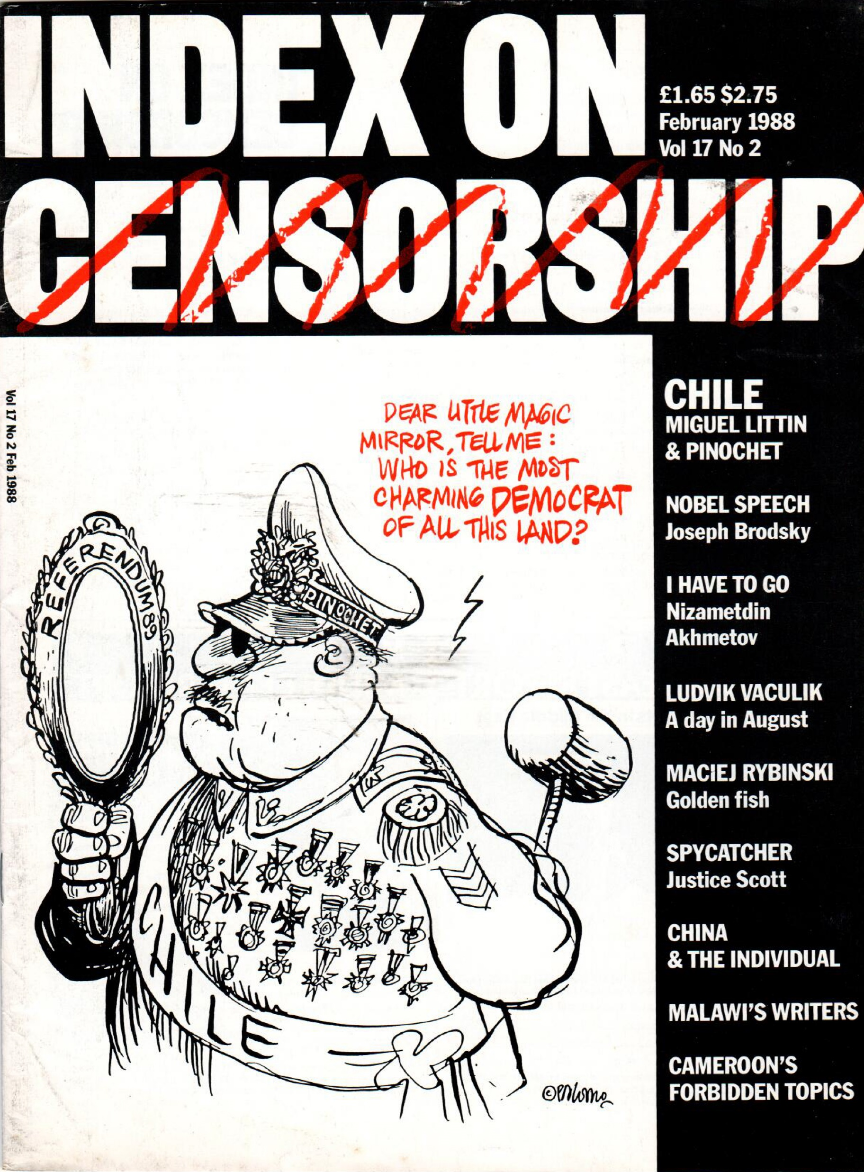
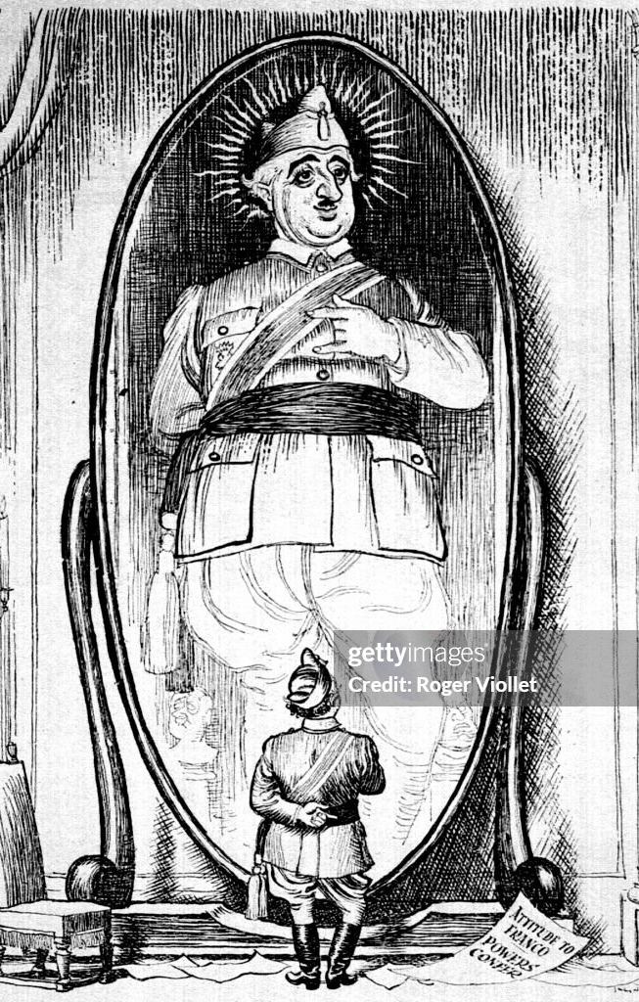
Tyranny in Literature and Film
Jonathan Ablard
HIST 450
MW 2pm-3:40pm

Slide 3
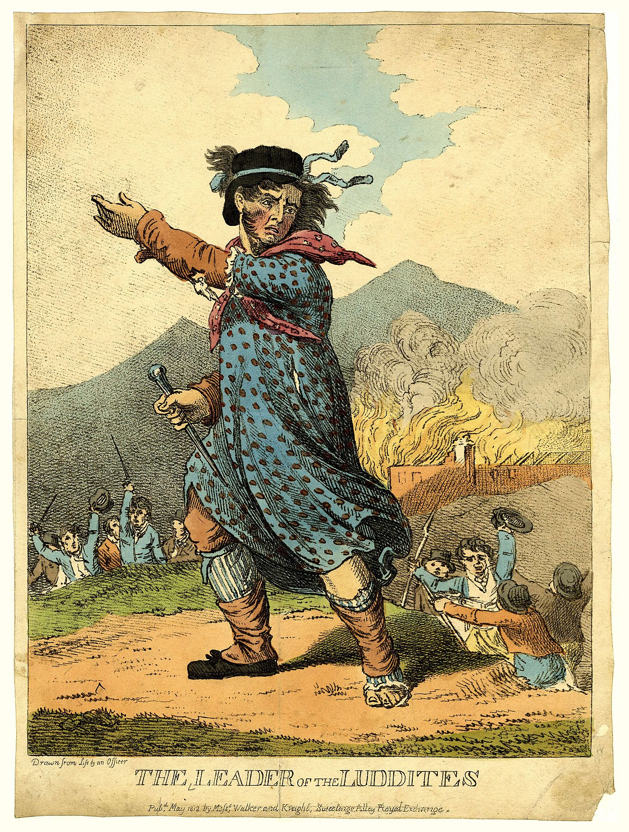
History 141
From the Margins: European Social History, 1400-1945
Prof. Karin Breuer
MTWF 9:00-10:10
This course traces the history of minority and marginal groups in Europe from the Renaissance to the end of the Second World War. It carries a diversity designation for the ICC.

Slide 4
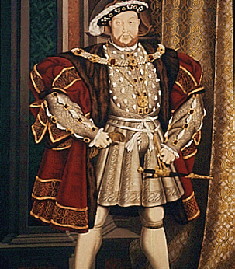
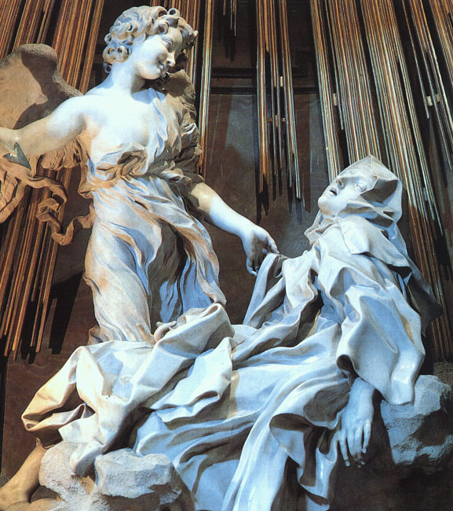

HIST 30100: Renaissance and Reformation Europe
MWF 11:00-11:50 a.m., T 8:00-8:50 a.m.
Karin Breuer

Slide 5
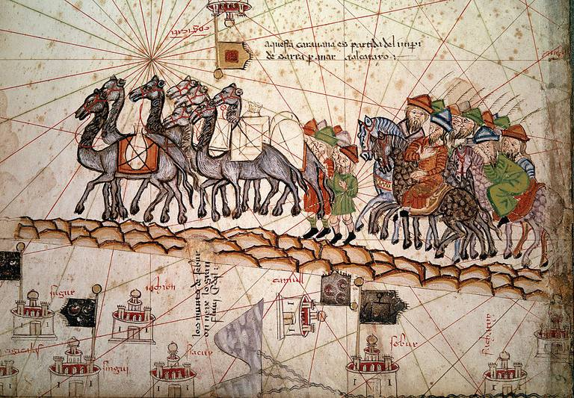
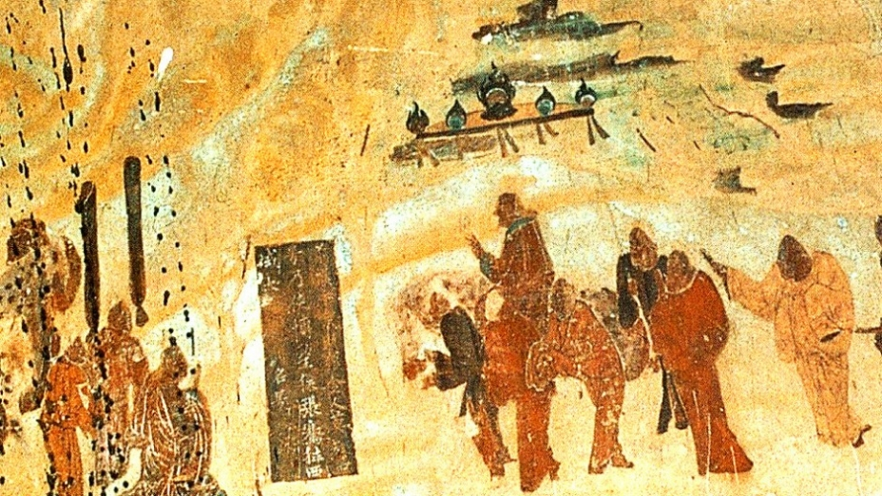
History 181: Becoming Global: The World to 1500
Prof. Jason Freitag
TR 10:00-11:15 am & W 4:00-4:50 pm
This course covers the emergence and development of world civilizations from prehistoric times to approximately 1500 CE. Students will become familiar with the development of and interactions between peoples, states, civilizations, and empires. A few themes include: the evolution of different socio-political organizations, cultural encounters in various forms, gender and family, and the development of intellectual ideas and world religions.

Slide 6
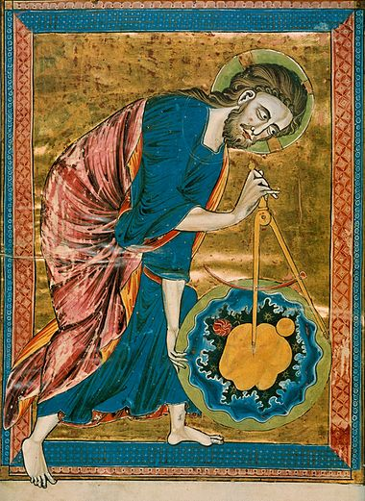
HIST 230: Science and Religion from the Ancient Near East to the Scientific Revolution
Prof. Klemm M 3:00-3:50 & TR 1:00-2:15 pm
Examines interactions between science and religion from the ancient Near East through the scientific revolution in the seventeenth century, It focuses on ways the development and transmission of scientific ideas depended on different religious contexts from Mesopotamia to Greece, Egypt, Rome, the Islamic world, and finally to medieval and early modern Europe.

Slide 7
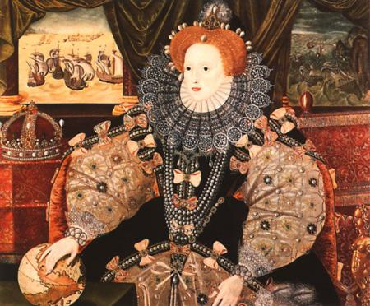
History 11100 US History to 1877
Prof. Amanda McGee MW 8:35-9:50 &
F 9:00-9:50

Slide 8
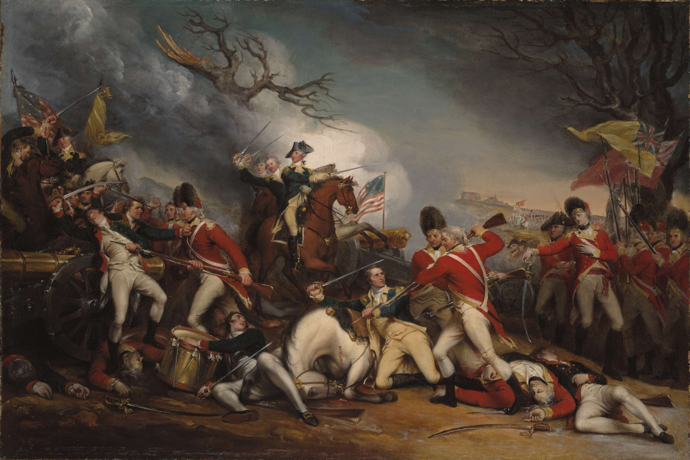
HIST 30400: The Age of The American Revolution
MW 12:00-1:15 PM &
F 12:00-12:50 PM
Professor Amanda McGee
This class wrestles with the single most crucial era of American history: it’s founding. The class will interrogate:
The growing divisions between Britain and its colonies
The fight for independence
The founding of a unified, new United States

Slide 9
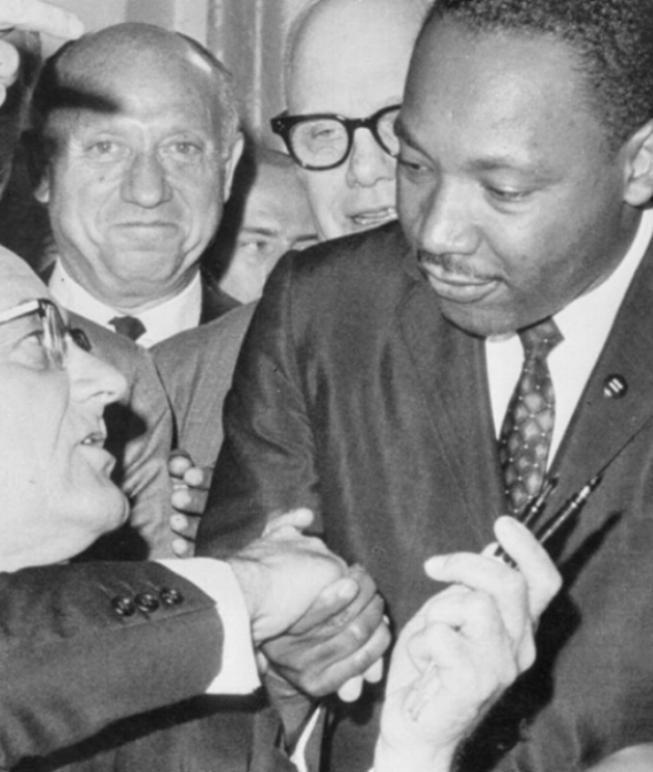
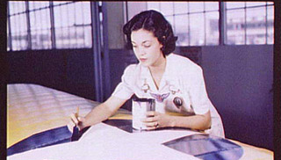
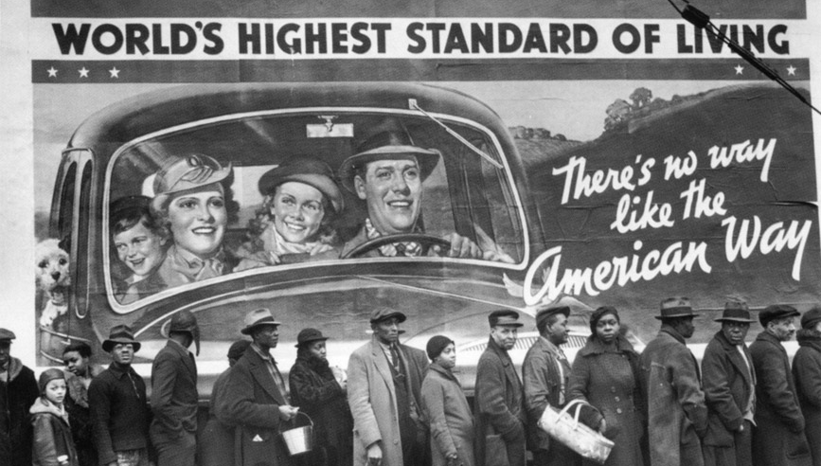
This course explores major issues that led to the making of the modern United States. It pays attention to social and intellectual currents, labor and business, immigration and ethnicity, race and gender, the development of reform and radical activities, war, Progressivism and the New Deal, women’s liberation and civil rights (Diversity)
History 112: Building Modern America (US History since 1877)
Prof. Michael Smith
TR 8:35 am – 9:50 am
HIST 112: US History since 1877
Prof. Smith MW 4-5:15

Slide 10
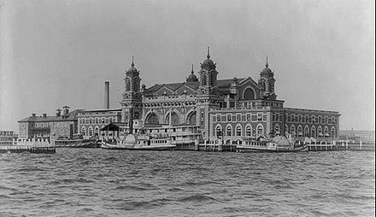
History 209:
Workers in American History:
The Story of Immigration, Race, and Class
TR 3:00 - 4:15 & F 3:00 - 3:50 pm
Prof. Michael Trotti
This course explores:
Waves of immigration and migration;
America’s evolving history of race, racism, and diversity from multiple perspectives;
Unions, anti-labor violence, and the rise (and fall) of the American working class;
A family history paper, linking students’ own family histories to our historical themes.
[Image: Ellis Island]

Slide 11
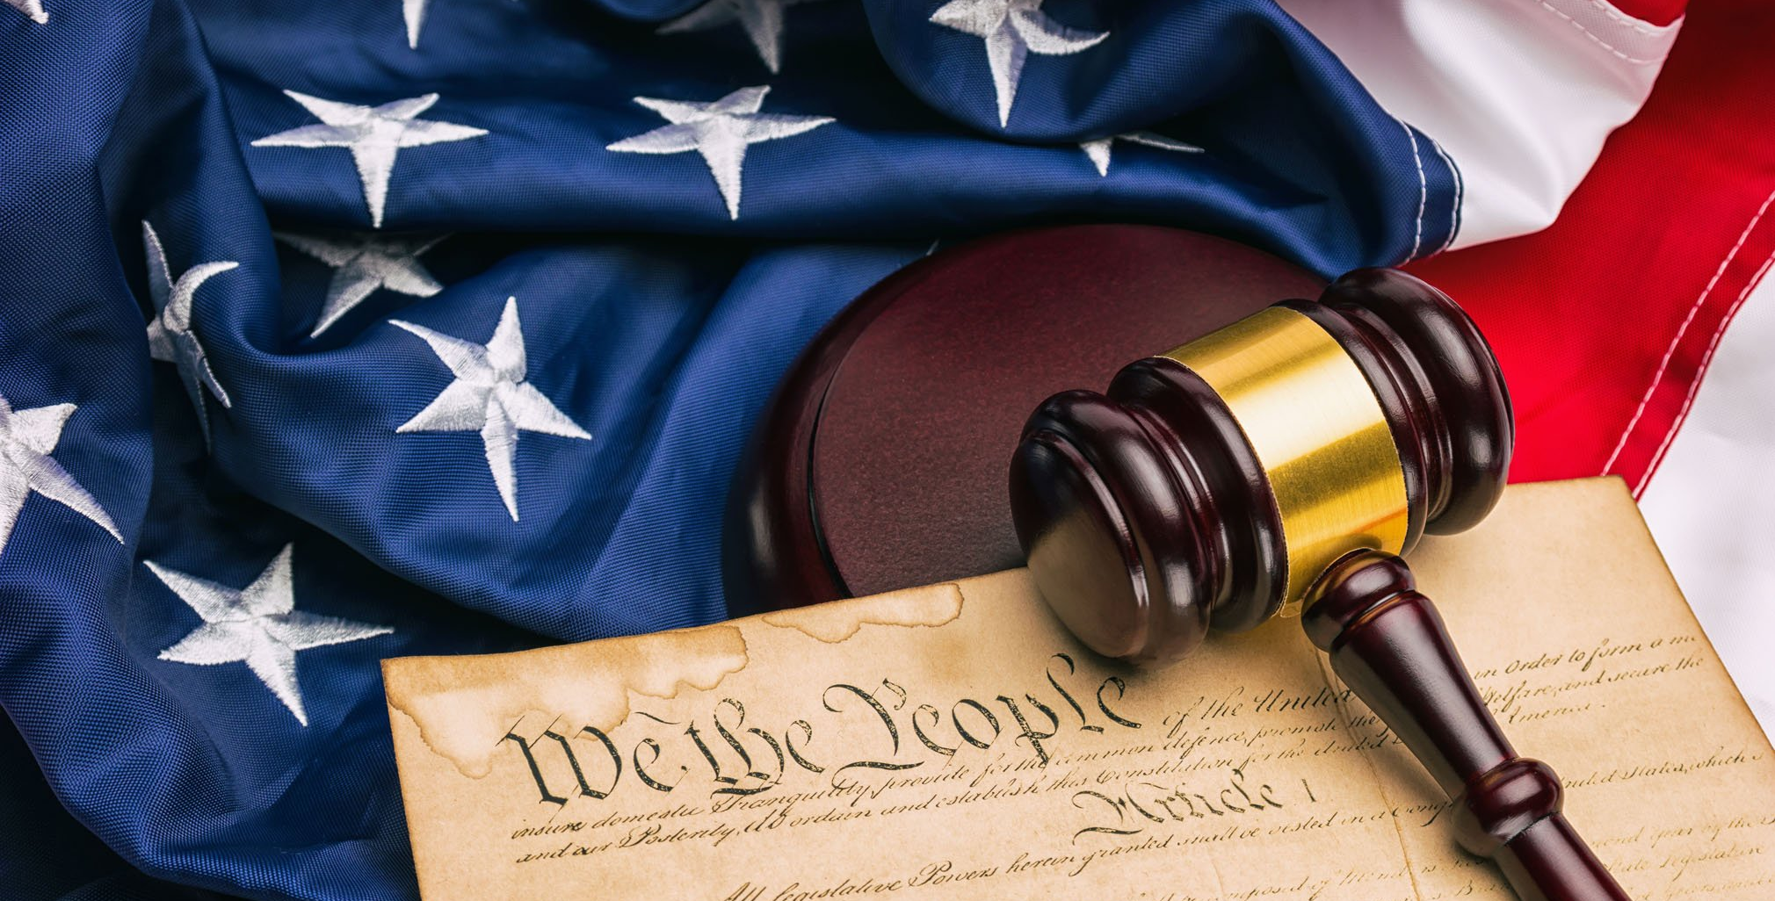

History 212:
Rights & Wrongs:
The History of American Law
Prof. Michael Trotti
MW 12:00-1:15 pm
F 12:00-12:50 pm
Explores the Constitution and the history of its interpretation (rights) and how our legal system, both criminal and in terms of those constitutional rights, has so often fallen short (wrongs).
Considers concrete examples drawn from the legal system, the explosive growth of our prison populations, and shifting interpretations of privacy, the right to bear arms, race, and gender. Students gain a deeper understanding of U.S. law as a human construct that is changeable, fallible, and correctable.

Slide 12

History 106
Prof. Zenon Wasyliw
MW 10:00 – 11:15 am & F 10:00-10:50 am OR
MW 2:00 – 3:15 pm & F 2:00-2:50 pm
History in the News: Global Identities and the Search for Justice
Introduces the field of contemporary history through an examination of current events and issues. Students follow international developments and offer historical contexts and evaluations within themes of global identities and the search for justice through the paradigm of globalization and human rights.

Slide 13

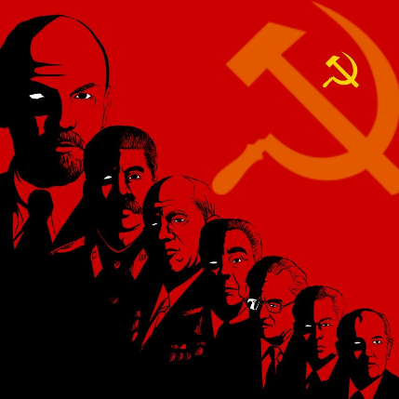
History 222: The USSR: History and Legacies (Identities & World of Systems)
Prof. Wasyliw TR 10:00 – 11:40 am
The USSR: History and Legacies evaluates the rise and fall of the Soviet Union and its legacies in contemporary times, including post-Soviet Russian and Ukrainian influence in American politics and the world. We will apply, throughout the course, an interdisciplinary political, intellectual, social, cultural, economic approach in assessing policies, leaders, and their impact on everyday life with a special focus on Stalin and Stalinism. The study of Soviet history is extremely fascinating. We will engage in an interesting journey and evaluation of the Soviet past and its influence on the present and future.

