Slide 1
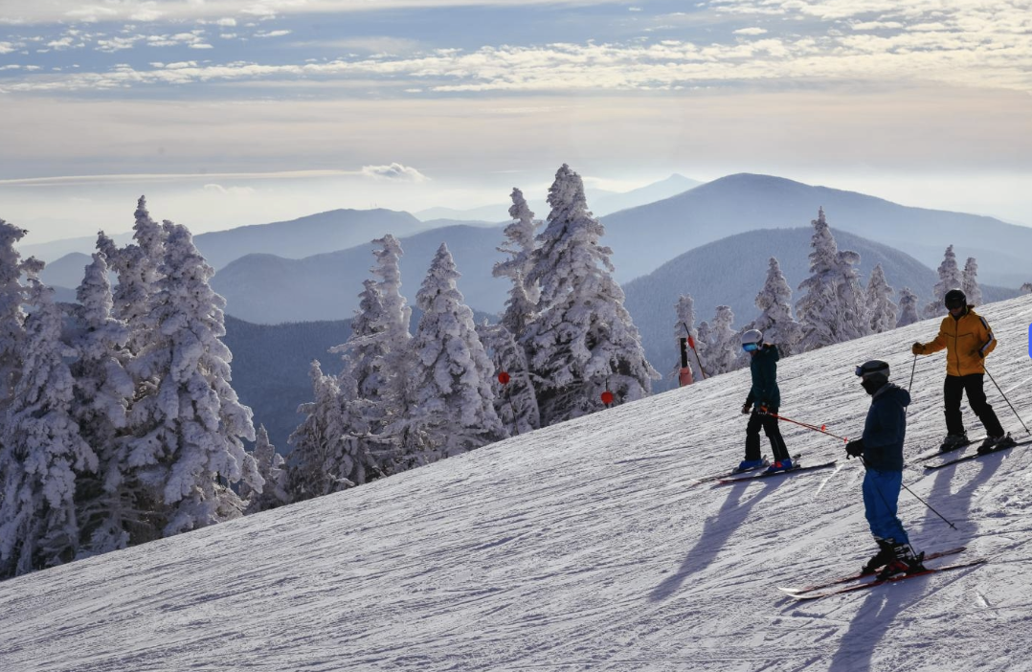
Mountain Narratives in Motion: A Collaborative Digital Media Project Involving AAC and Adaptive Skiing
Provost Colloquium Spring 2026
Sabbatical Project
David J. Hajjar, Ph.D., CCC-SLP
Associate Professor
Ithaca College

Slide 2
Aim & Purpose
Implement a community engaged creative project, grounded in the framework of participatory action
Three different stakeholder groups; Greek Peak Adaptive Snowsports, Ithaca College & a local family in Ithaca
Capture meaningful digital media to create visual supports for communication
Develop a short film to promote & educate others about adaptive snow sports, augmentative and alternative communication(AAC) &the importance of community
Notes:
Media arts sciences and studies

Slide 3
Clip #1: Meet Andrew & GPAS
First- year student at IHS who uses AAC
Lives with parents & younger brother
Enjoys skiing & other outdoor pursuits
Greek Peak Adaptive Snowsports Program (GPAS)
GPAS Volunteers support children & adults in a highly motivating natural outdoor setting
Notes:
A great setting for capturing and collecting digital media!
Tablet device with specialized communication software. A synthesized voice has been selected by Andrew and is what you hear from the AAC system output. Andrew’s Language system is organized in a series of folders and grid based design. In addition we have started to use larger photos and digital media to support communication engagement and interaction with others.

Slide 4
Clip #2: Volunteers Create Community
Abby, pediatric physical therapist & GPAS volunteer
Jeanne, program director at GPAS (former special educator)
The people and the setting provide opportunities for communication & social interaction
Volunteers love snow sports, but may not have experience supporting people with disabilities
Social networks & snow sports create a unique experience for participants and volunteers

Slide 5
Clip #3: Family Support
Jen and Paul provide support across many levels for Andrew
Cerebral palsy impacts Andrew’s physical/motor ability, communication, social interactions, participation in daily routines and overall independence in tasks
Andrew’s family has exposed him to many outdoor and active recreational pursuits such as; biking, kayaking, going to concerts, fishing, boating, camping, etc.

Slide 6
Clip #4: Ithaca College/SLPG
  Students earn clinical hours supporting community members
  AAC is one specialty area in the field of SLP
  Tablets and other devices are communication tools for non speaking children & adults
  Personalized digital media provides visual supports for communication and social interaction
Notes:
Media Arts Sciences and Studies
Documentary Film Studies
Interview/Qualitative/Participatory approach
Capturing digital media from different perspectives & telling a story
Creating a short film with input from all stakeholders

Slide 7
Appendices & Thank You!

Slide 8
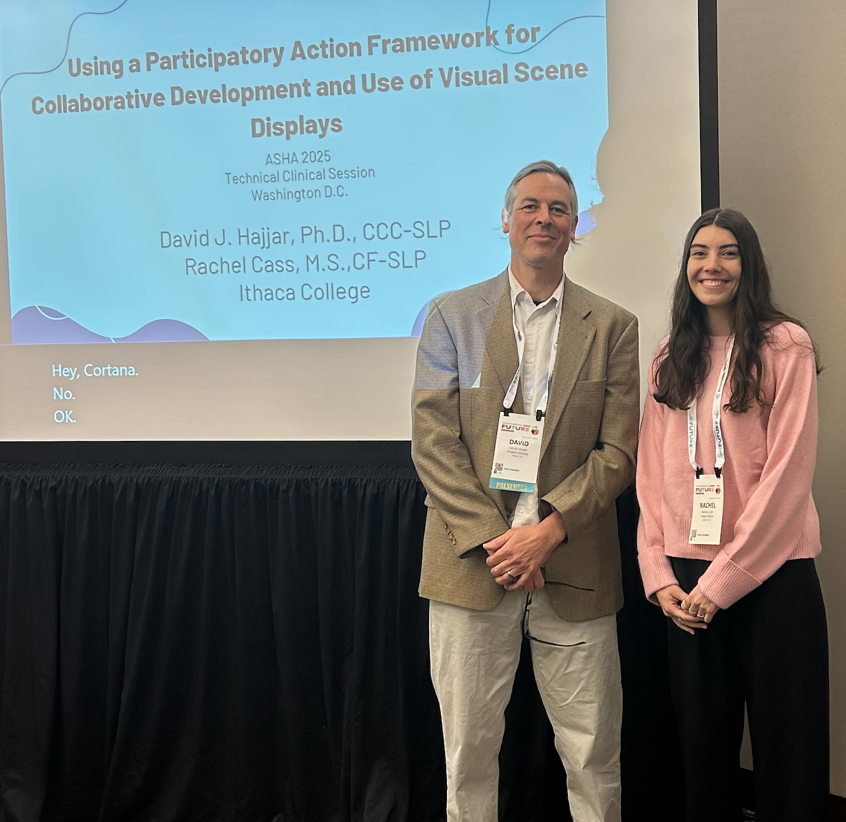
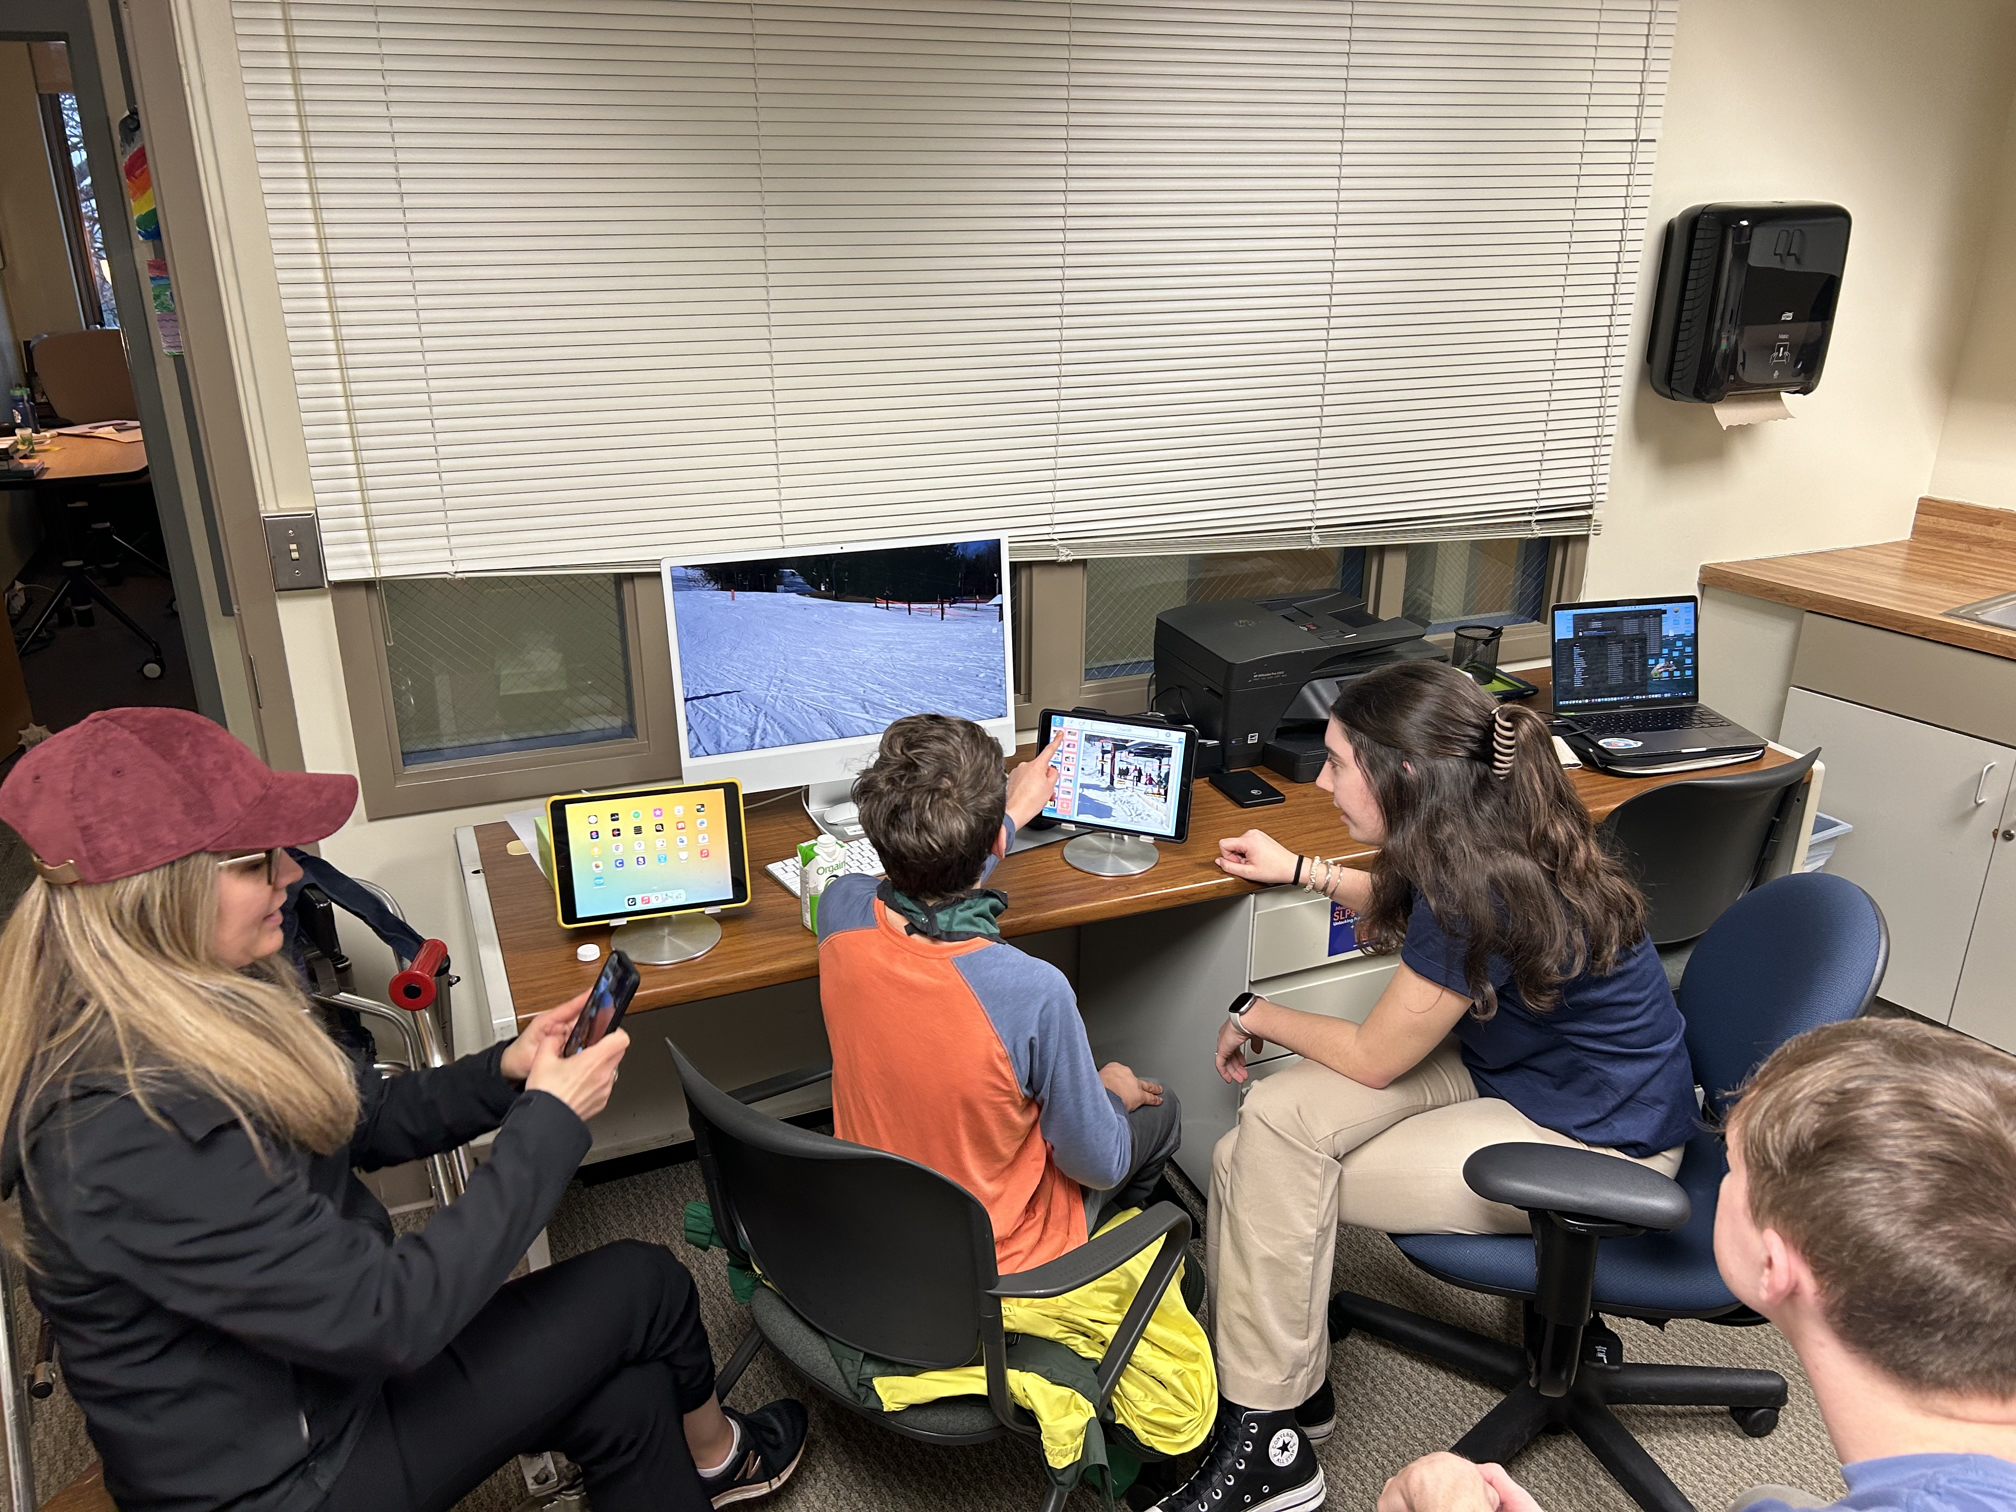
SLP Graduate Students

Slide 9
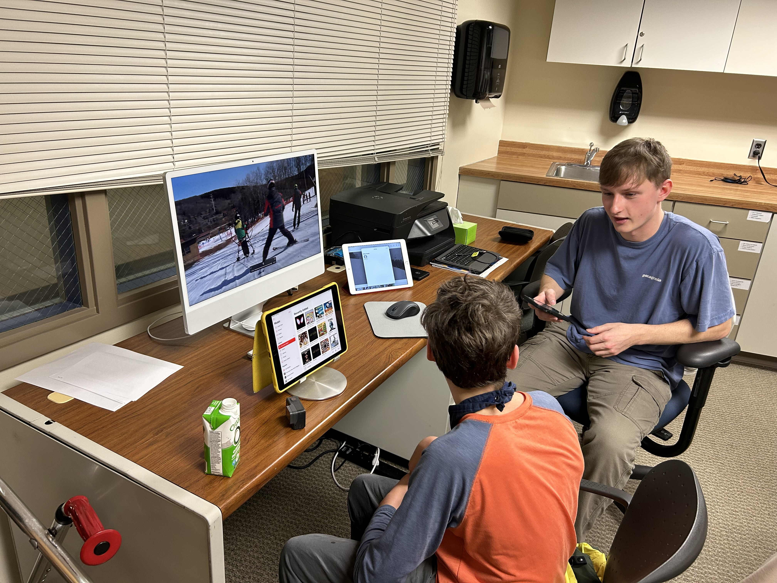
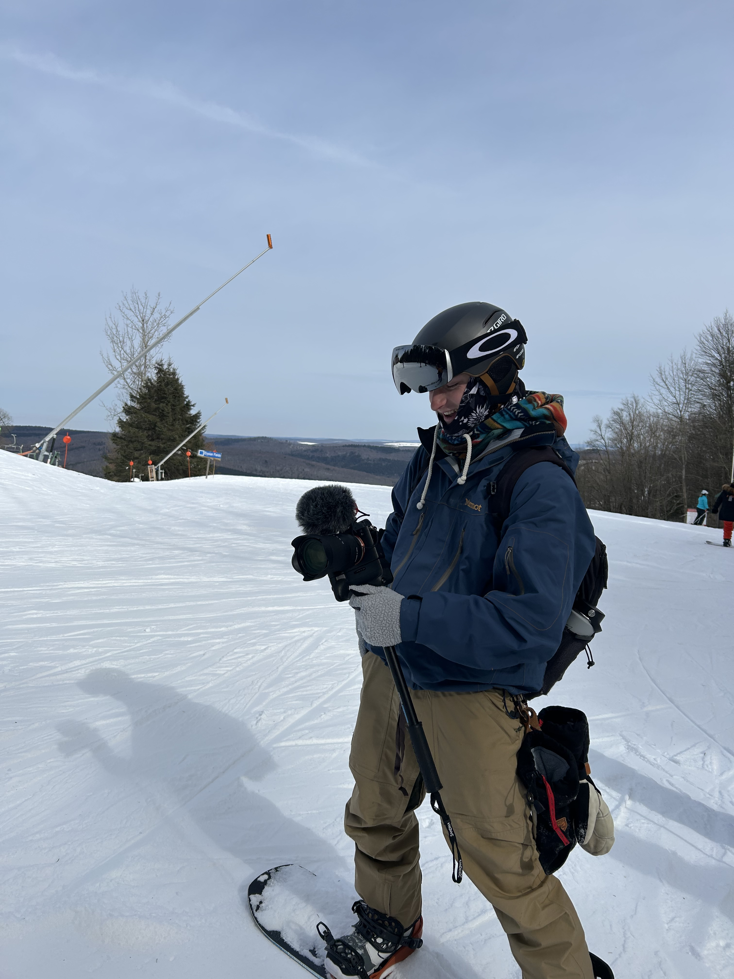
Documentary Film Student/s

Slide 10
Thank You
Andrew and his family
GPAS staff and volunteers
Jack Punda
Rachel Cass
Paige Stewart
Mack Becker
Charlie Nichols
SLPA Department
Dr. John Scott
Notes:
Creative Project: Mountain Narratives in Motion: A Collaborative Digital Media Project Involving AAC and Adaptive Skiing
See the link to a slide deck presenting the short film titled: No Community without Communication". The film was produced and directed by IC alumni Jack Punda '25 in collaboration with Dr. Hajjar and students from the SLP graduate program. See the link below to view the clip on YouTube.

Slide 11
Film: No Community without Communication
https://www.youtube.com/watch?v=3dF1vH7FBwA

