Slide 1

History Courses
Fall 2026

Slide 2
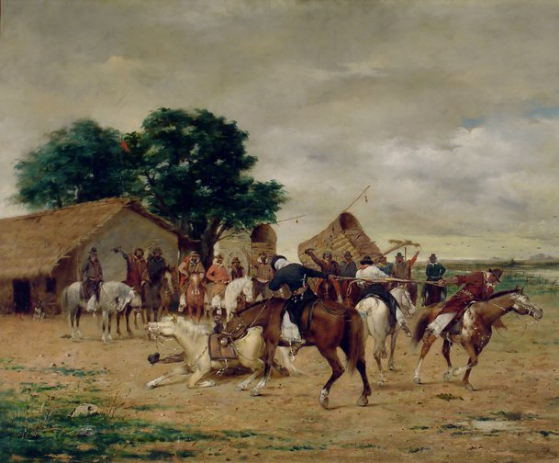
Modern Latin America (HIST 234) M 3:00-3:50 & TR 1:00-2:15 Professor Ablard

Slide 3
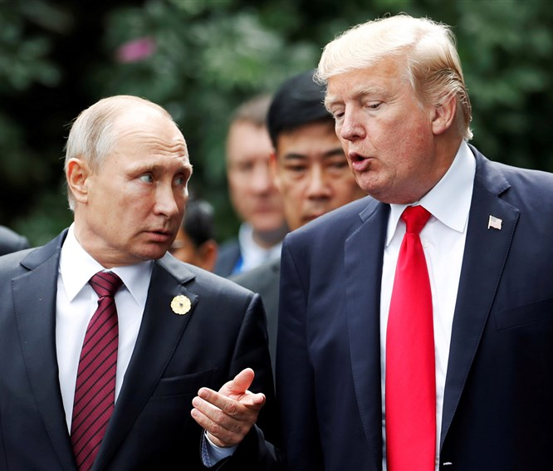
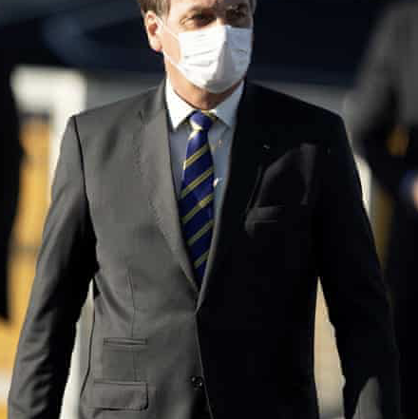
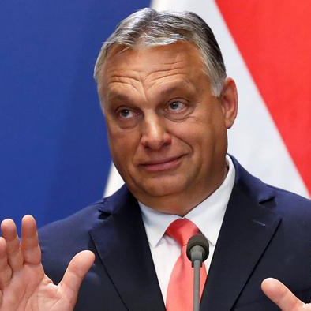
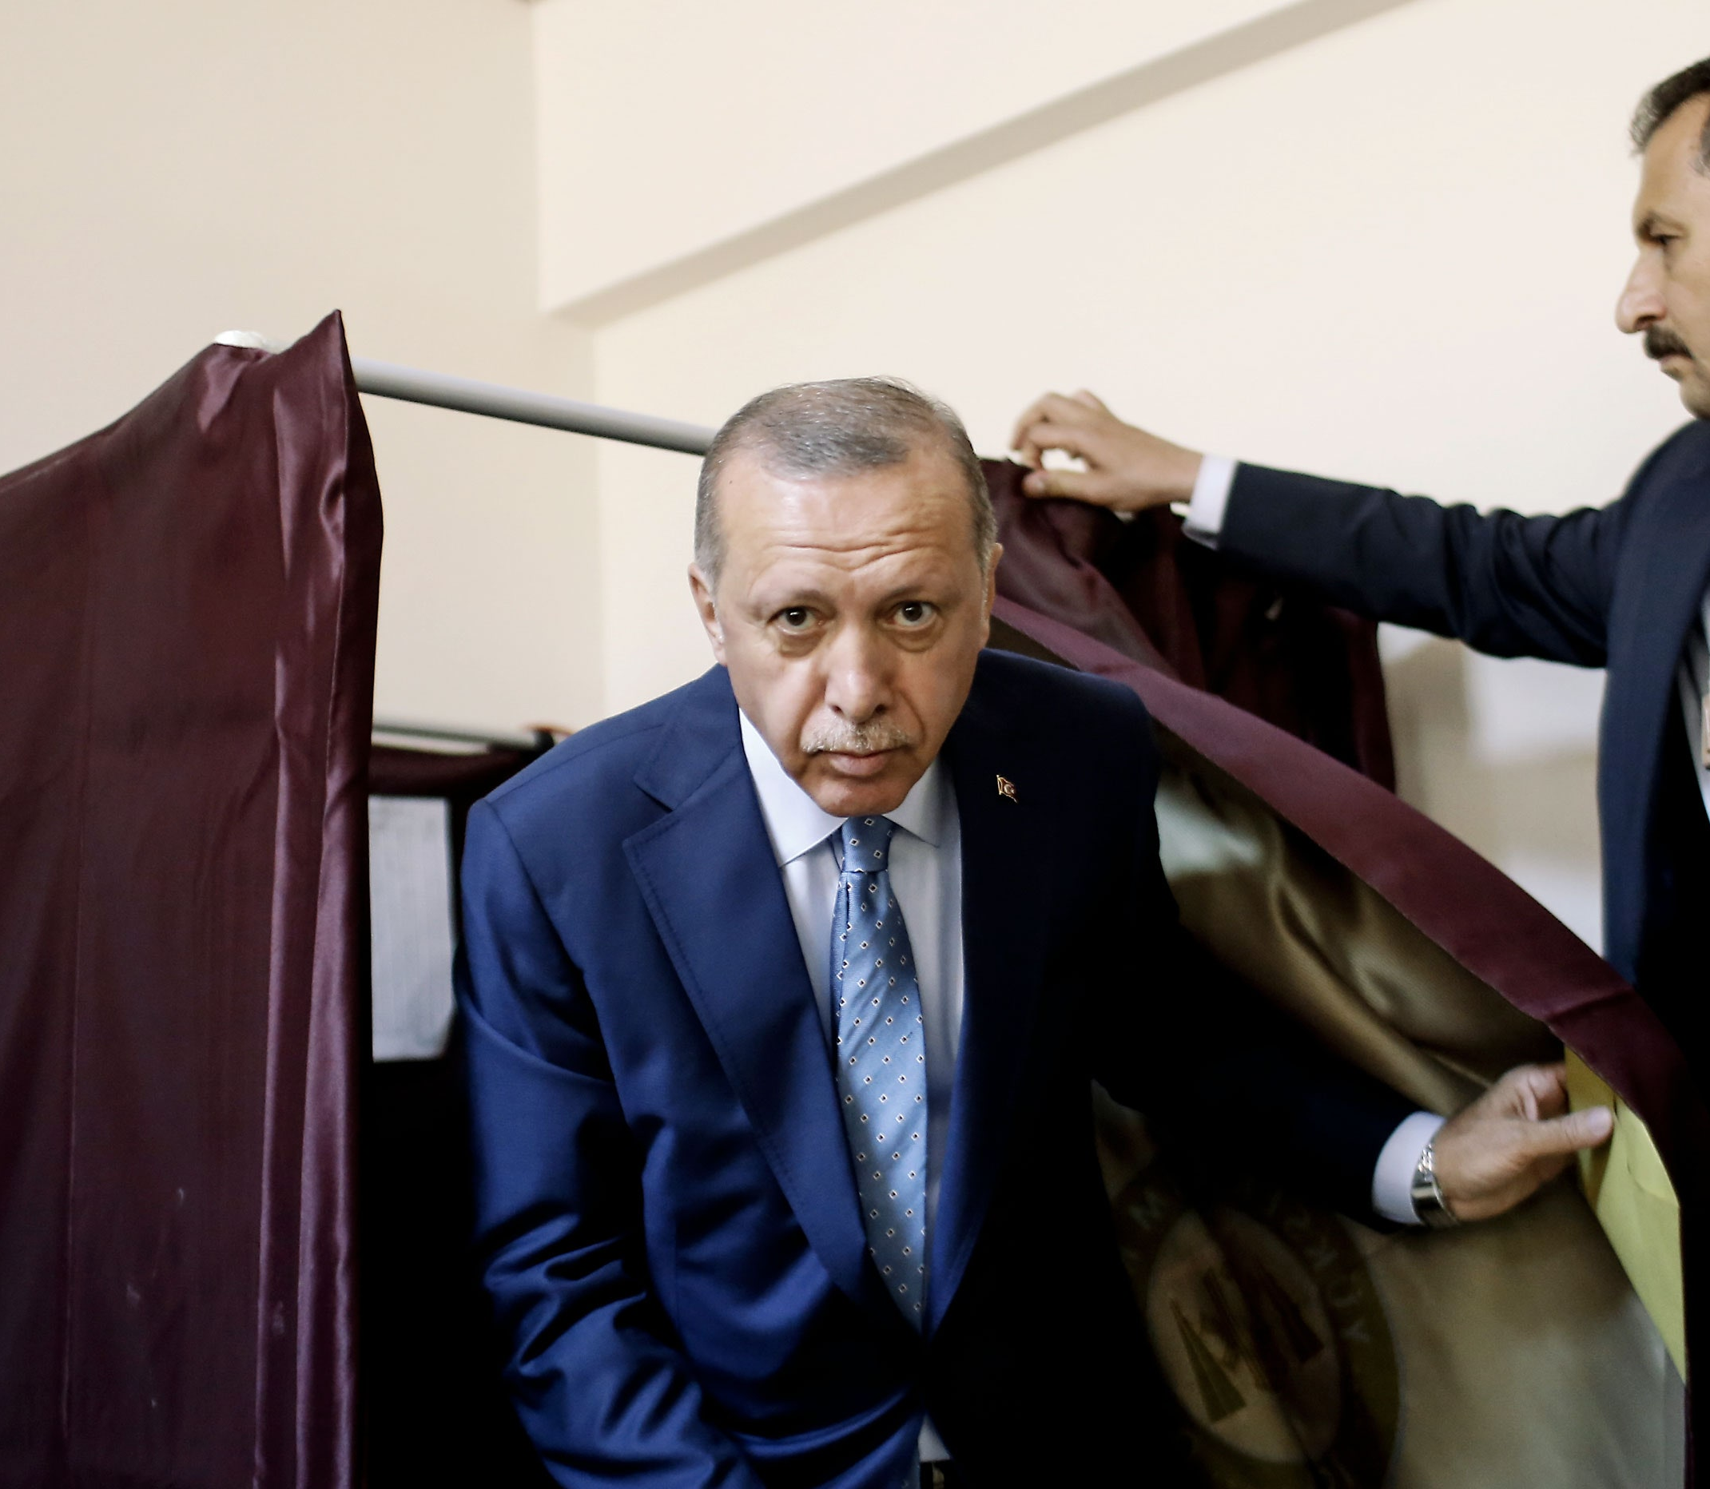
History 380 A Global History of Lies Professor Ablard M 4:00 - 4:50 TR 3:00 - 4:15
Considers how a confluence of technological, economic, political and social forces have reshaped the contours and possibilities of misinformation and disinformation and their role in the development of rumors, conspiracy theories, and hoaxes. Focusing on Europe, the United States, and Latin America, we will trace the arc of conspiratorial thinking and rumors from the European Wars of Religion to the era of Trump, Putin, Bolsonaro, Orban, and Erdogan. This course counts toward the global requirement for department majors.

Slide 4
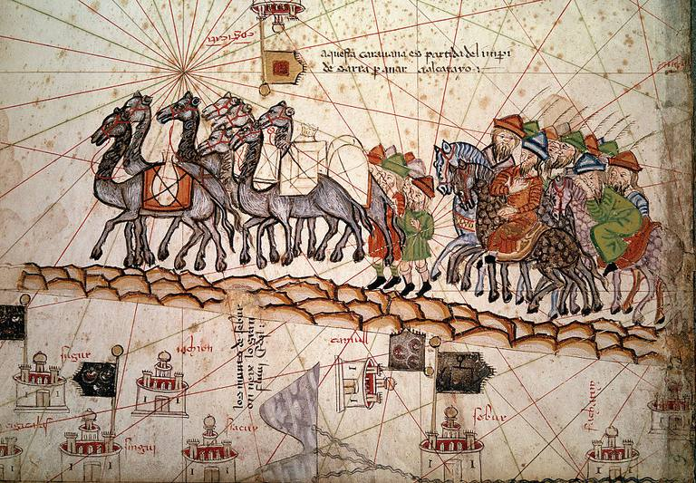
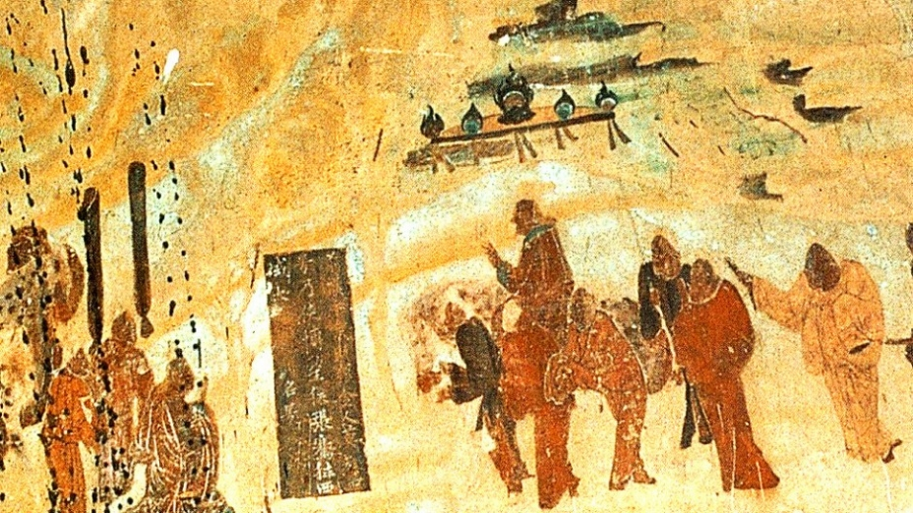
History 181: Becoming Global: The World to 1500 Prof. Jason Freitag TR 1:00-2:15 & W 3:00-3:50
This course covers the emergence and development of world civilizations from prehistoric times to approximately 1500 CE. Students will become familiar with the development of and interactions between peoples, states, civilizations, and empires. A few themes include: the evolution of different socio-political organizations, cultural encounters in various forms, gender and family, and the development of intellectual ideas and world religions.

Slide 5
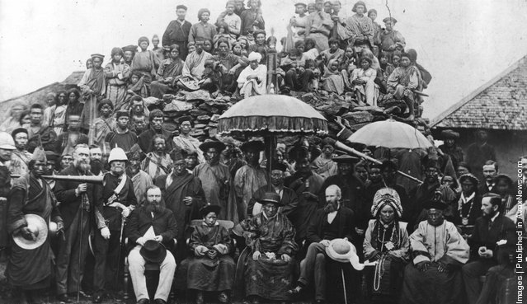
Prof. Freitag HIST 223 The British Empire TR 3:00-4:15 & W 4:00-4:50
.This course will examine how and why Great Britain (a country half the size of France) acquired such a vast empire. The class will look at the scope of the empire – settlements and colonies in North America, Australia, New Zealand and South Africa; dependencies and protectorates in Africa and the Middle East; and finally the jewel in the imperial crown, India – and how the populations in both Britain and the colonized regions responded when faced with this empire. The class will also examine the technologies of power that enabled Britain to administer such a large area, and the ways in which imperial power was implicated in the construction of knowledge that introduced many of these places to a European audience, and formed the original basis of modern scholarship on much of the world. Finally, the course will focus on the dissolution of the empire in the twentieth century and the post-colonial legacy that continues to shape these former imperial possessions, as well as the modern British state. Counts towards the global history requirement for history department majors.

Slide 6
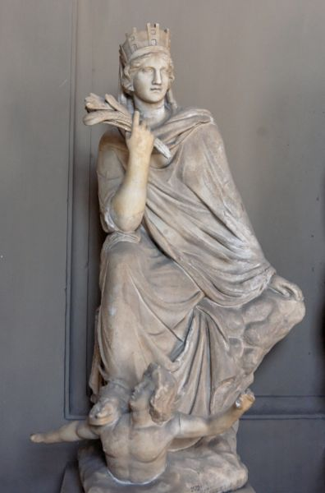
History 101: Before Europe: Cultures of the Premodern West 3 credits Prof. Klemm MW 10:00 - 11:15 or MW 2:00 - 3:15
This course examines a selection of cultures from the beginnings of Western civilization in ancient Greece into the sixteenth century.
This course also has two ICC designations: Power and Justice and Identities.

Slide 7
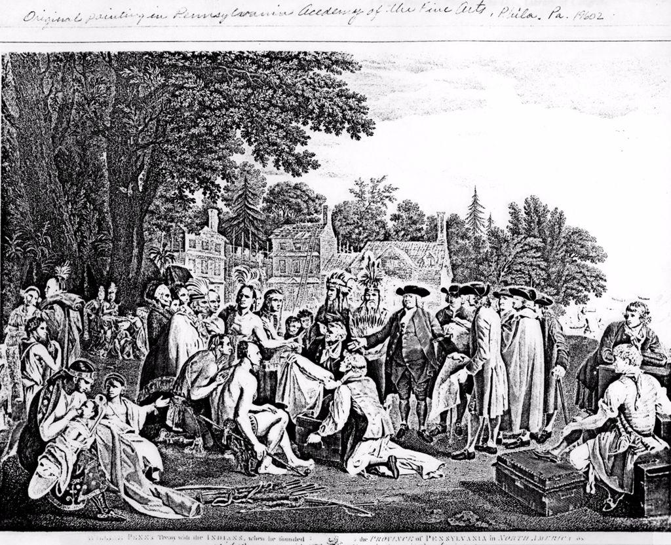
Prof. Amanda McGee
HIST 111 U.S. History to 1877
MW 8:35 – 9:50 &
F 9:00-9:50

Slide 8
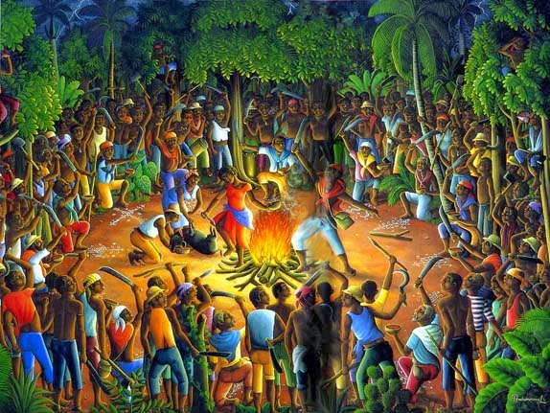
Prof. Amanda McGee History 257 Black Freedom in the Age of Emancipation TR 8:35 – 9:50 & F 8:00 – 8:50
This is a comparative Atlantic World course that examines Black freedom/Black liberation movements from about 1500 to 1900.
It focuses on the histories, meanings, and legacies of the various types of black emancipation in the Atlantic World and the cultural technologies that enabled them.

Slide 9
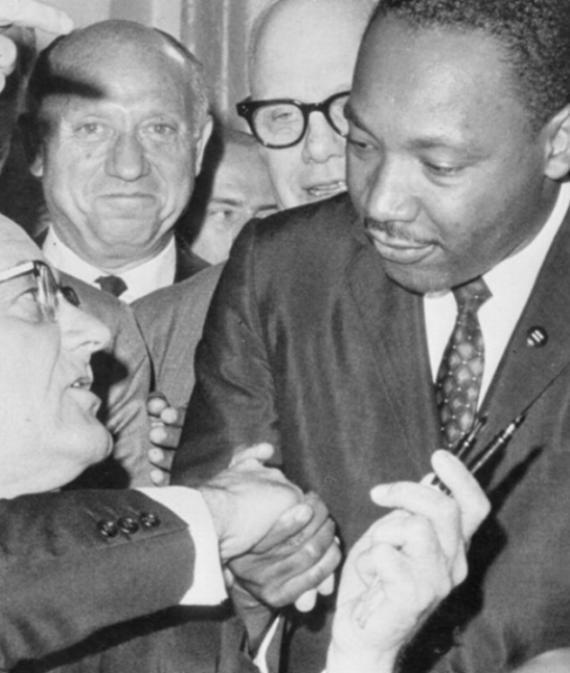
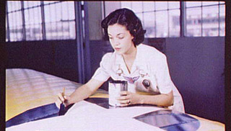
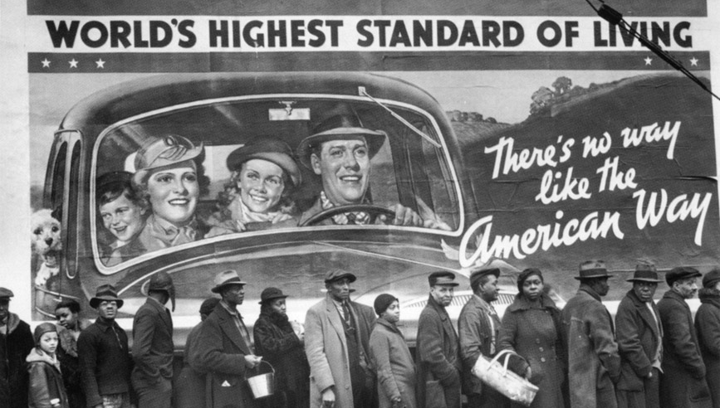
This course explores major issues that led to the making of the modern United States. It pays attention to social and intellectual currents, labor and business, immigration and ethnicity, race and gender, the development of reform and radical activities, war, Progressivism and the New Deal, women’s liberation and civil rights (Diversity)
History 112: Building Modern America (US History since 1877)
3 credits
Prof. Michael Smith
TR 8:35 am – 9:50 am
HIST 112: US History since 1877
Prof. Smith MW 4-5:15

Slide 10
HIST 45000 Seminar and Capstone: Energy in World History (4 cr) Prof. Smith, MW 10-11:15, F 10-10:50
The theme of this required senior seminar is the role of energy in world history: from the long era of biological energy to the shift to chemical energy to the current energy and climate crisis.
Expectations:
Significant reading load
Developing and honing advanced research and writing skills
Reflection on how those skills will help you in life after IC
This seminar also provides a capstone experience for History Majors. Students will reflect upon their learning in the various components of the ICC and their relation to the discipline of History. Students will connect their undergraduate work to the potential paths they will take after graduation.
By permission of instructor only.

Slide 11

Prof. Michael Trotti HIST 177 (1 credit) Voting: U.S. Elections in Historical Context R 8:35 – 09:50
Blue Wave? Election Irregularities? What is in store for us this Fall?
It is in midterm elections that change often starts (1930, 1978, 2006, 2010, 2018…). Let’s get some context…
Trump here is pictured daring you to not take this class.

Slide 12
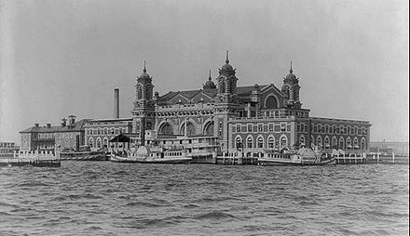
History 209: Workers in American History: The Story of Immigration, Race, and Class MW 8:35 – 9:50 & F 9:00 - 9:50 pm Prof. Michael Trotti
This course explores:
Waves of immigration and migration;
America’s evolving history of race, racism, and diversity from multiple perspectives;
Unions, anti-labor violence, and the rise (and fall) of the American working class;
A family history paper, linking students’ own family histories to our historical themes.
[Image: Ellis Island]

Slide 13
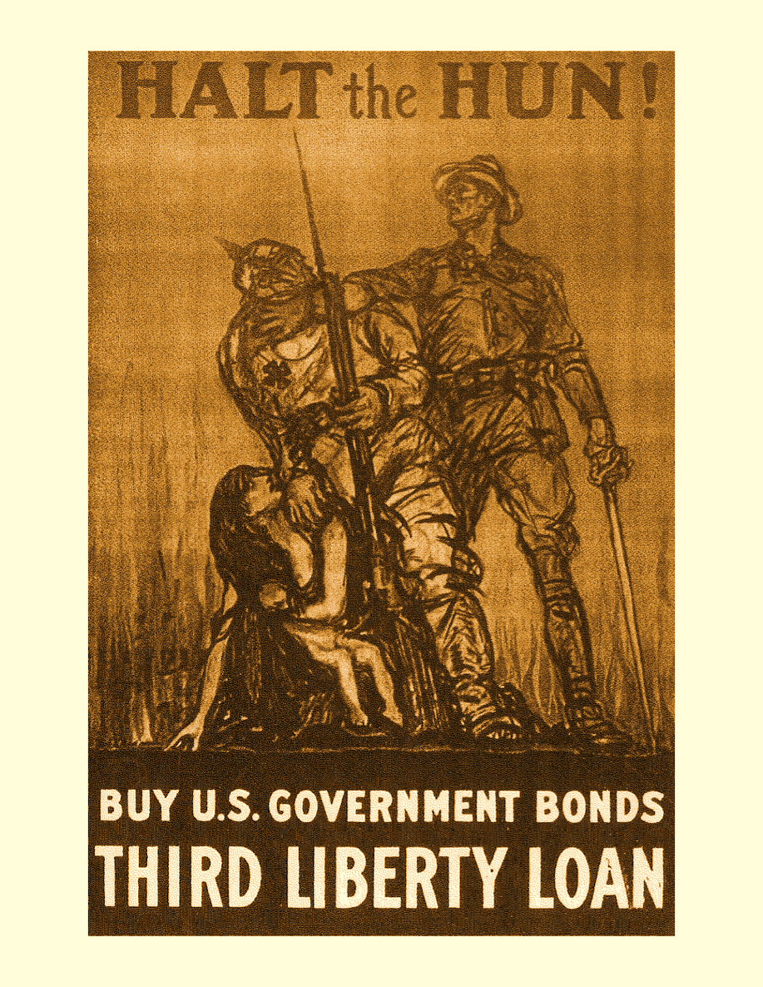
History 307 Prof. Michael Trotti MW, 2:00-3:15 & F, 2:00-2:50
The U.S.
in the Age of
Global Crisis, 1914-45
WWI;
"Roarin'" 1920s;
Great Depression; and
WWII.
In hardly a generation, the United States was transformed in ways that continue to define our national experience.

